Slide 1
Todd Myers & Team
Cangshan

Slide 2
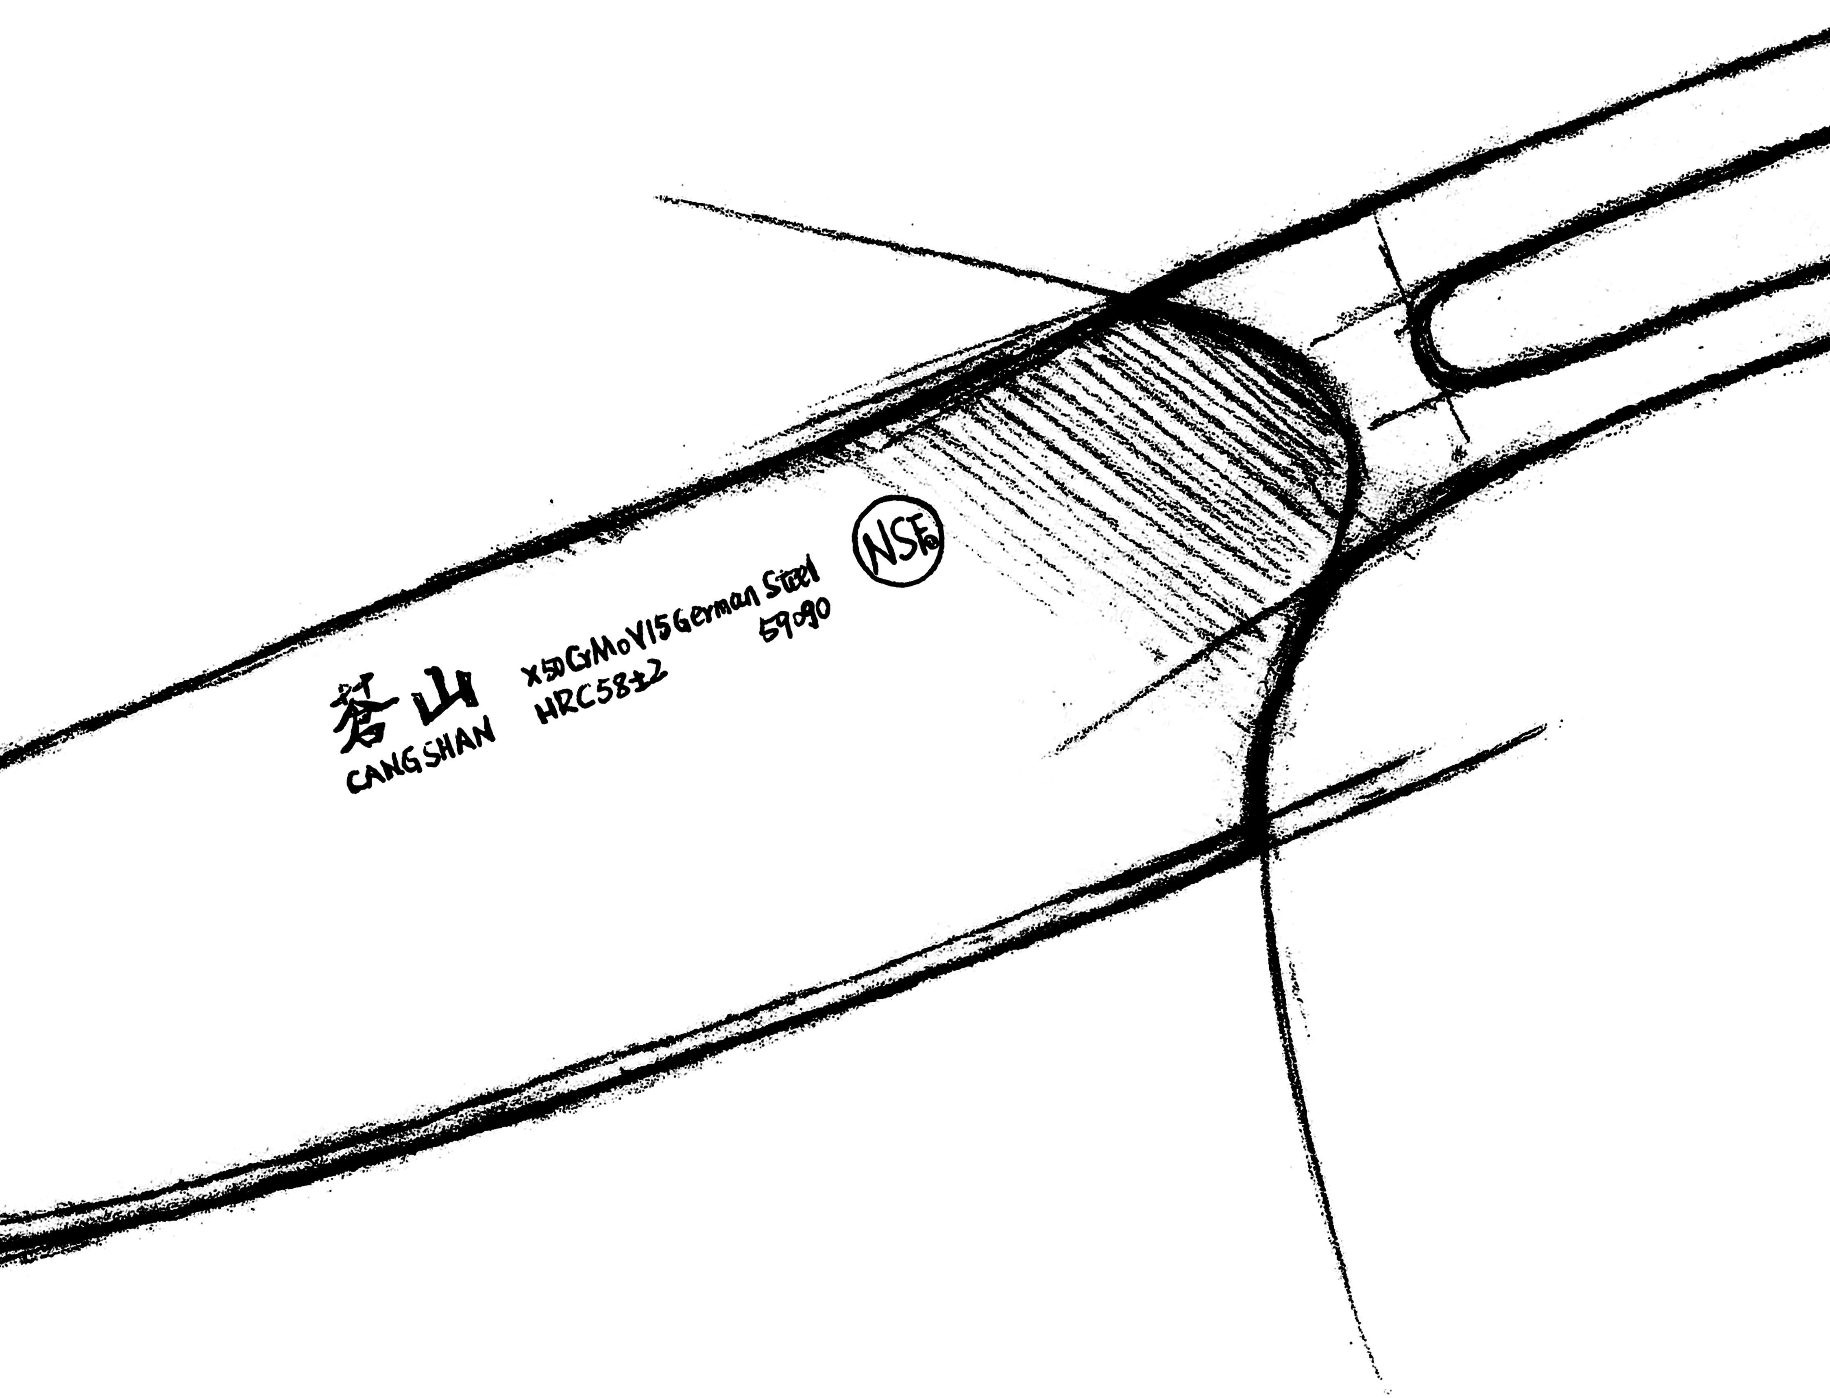
Andrew Curtis-Wellings – Austin, TX
Ed Bartush – Detroit, MI
Todd Myers – Minnesota

Slide 3
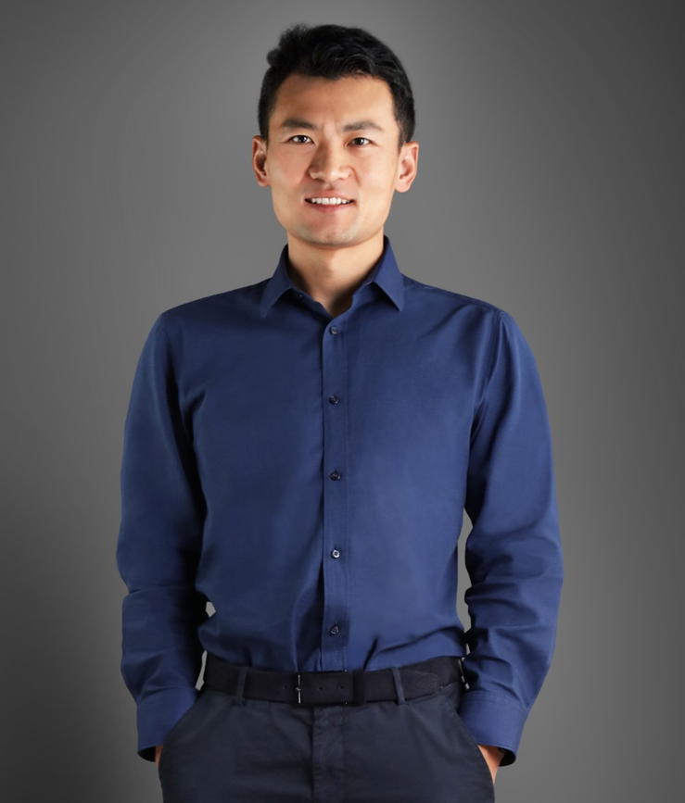
Who is
?
Our Story…
Henry Liu – Founder / Owner
Mechanical Engineer / Chief Designer
Moved Family to USA – 10 years ago
Researched Kitchen Cutlery – 2 for years
Started CANGSHAN – 7 years ago
Kind, Caring, Intelligent, Visionary

Slide 4
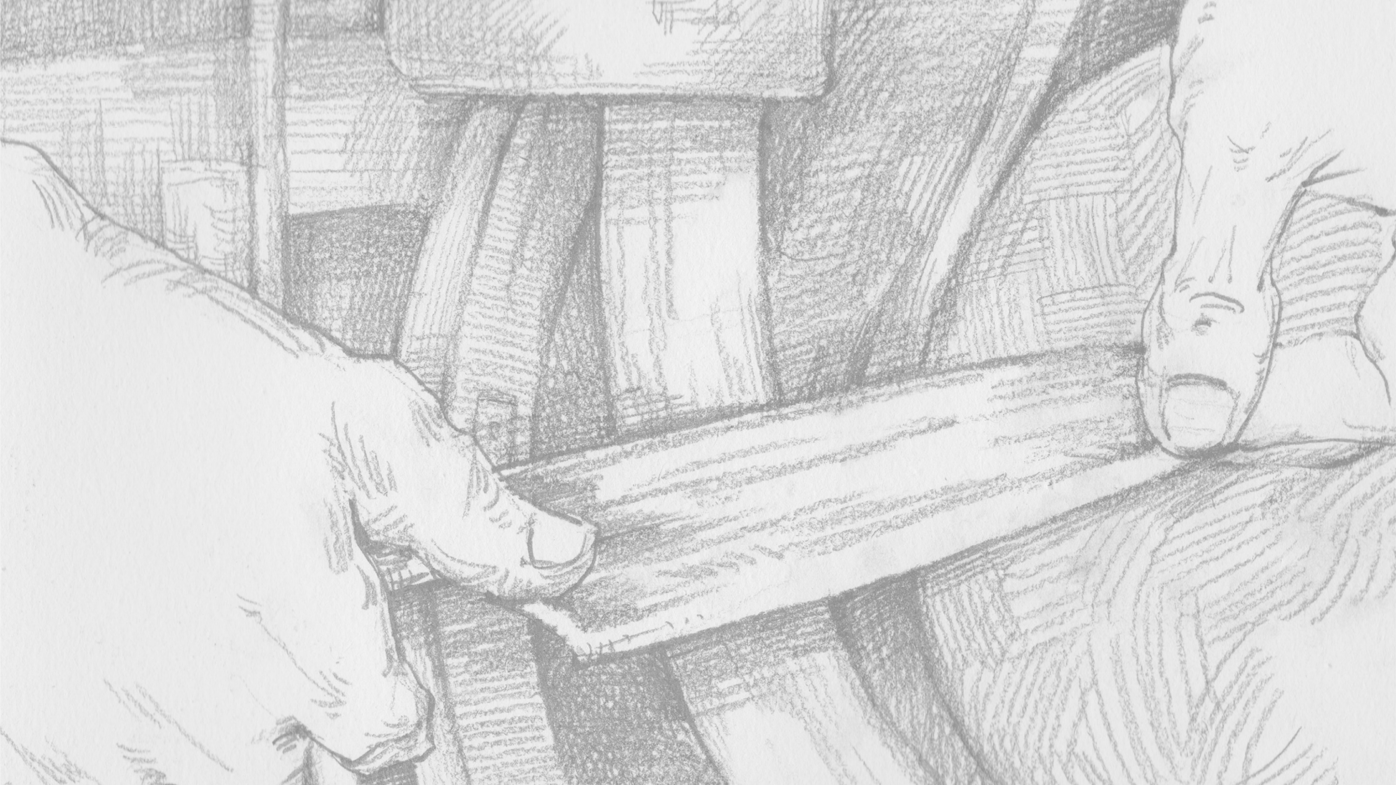
Opportunity:
Consumer Response
Growing Brand Recognition
Category “Disruptor”:
Accessible Premium Cutlery
Unique Story
World Class Innovation & Design
Best in Class Packaging & Storage
Superior Performance

Slide 5
32 Design Awards

Slide 6
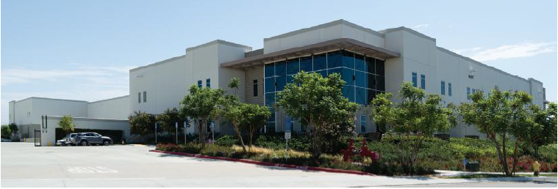
U.S. Company
Chino, California
2018-2022

Slide 7
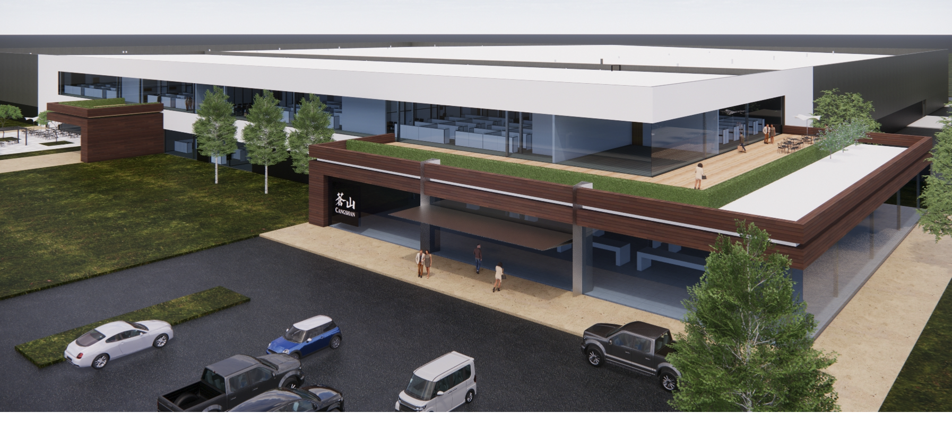
Austin, TX
Effective 7/1/2022

Slide 8
Manufacturing
2024 – Opening Knife Manufacturing
Made in Austin, Texas
(US Made Premium Gap)

Slide 9
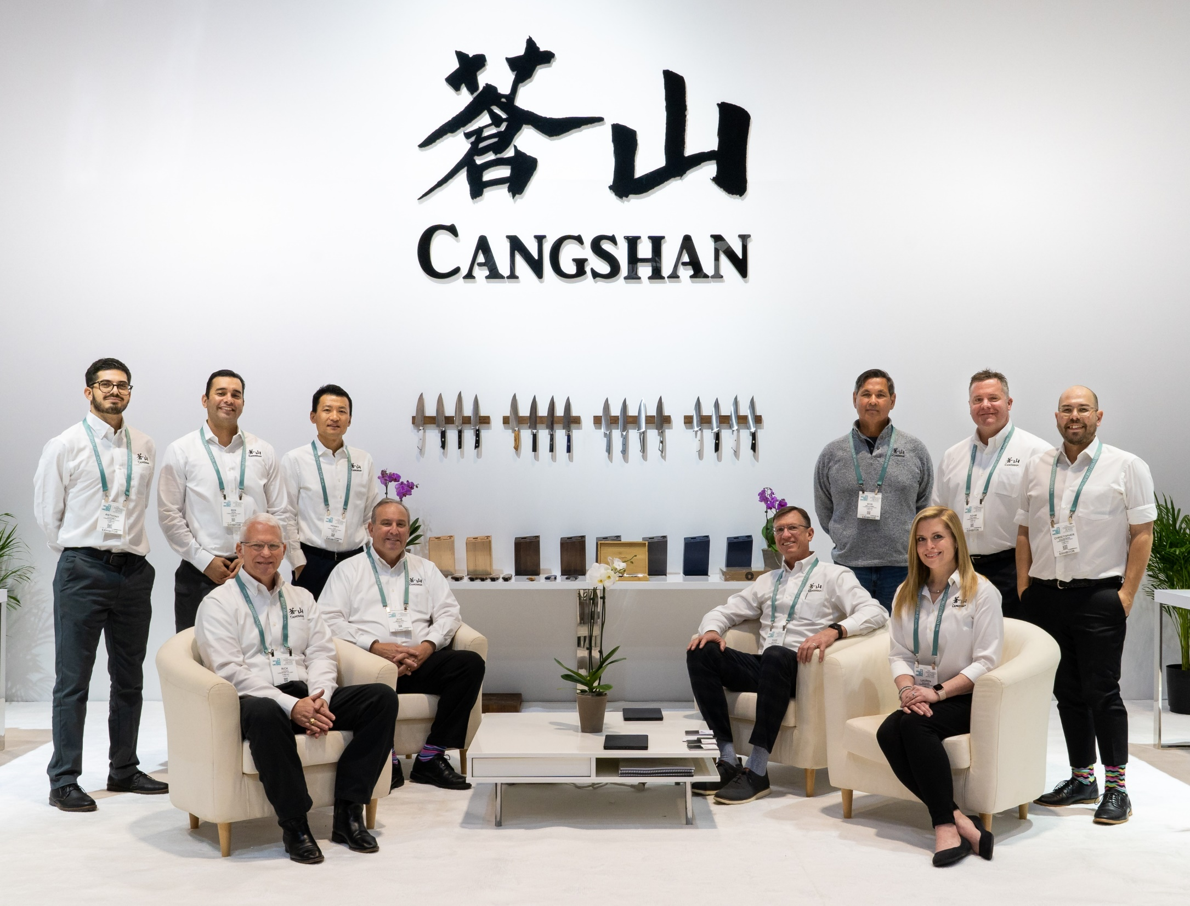
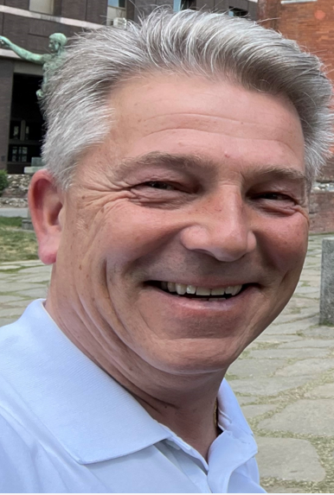
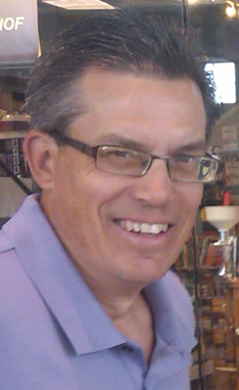
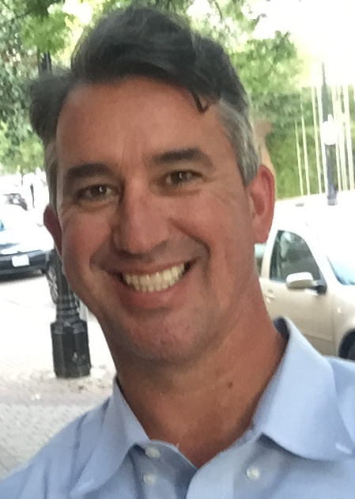
2022
Sales & Marketing Team
Claudio Tasillo

Slide 10
Retail Partners: 2022

Slide 11
Thomas Keller – Brand Ambassador
8
The French Laundry
Per Se
Bouchon
Surf Club

Slide 12
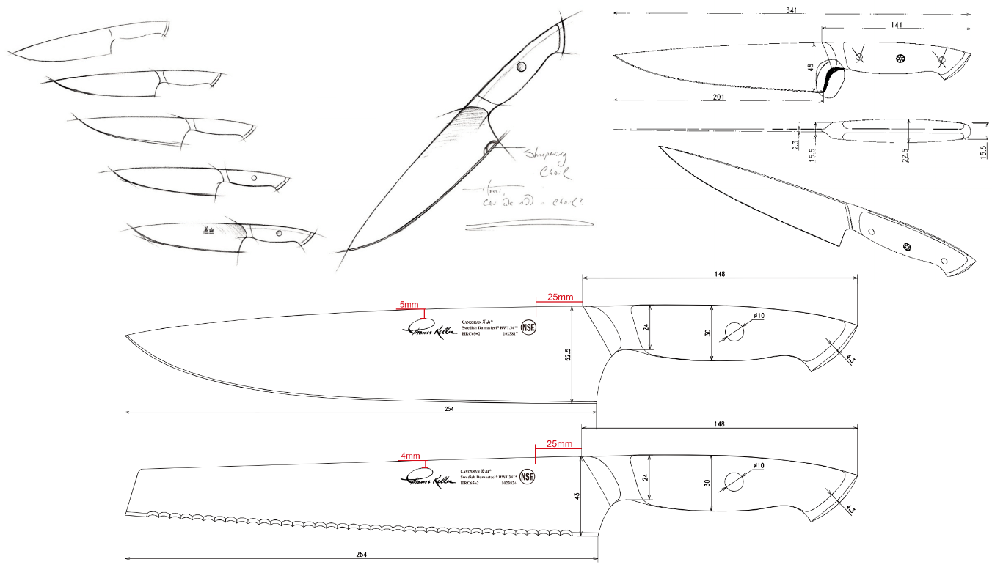

Slide 13
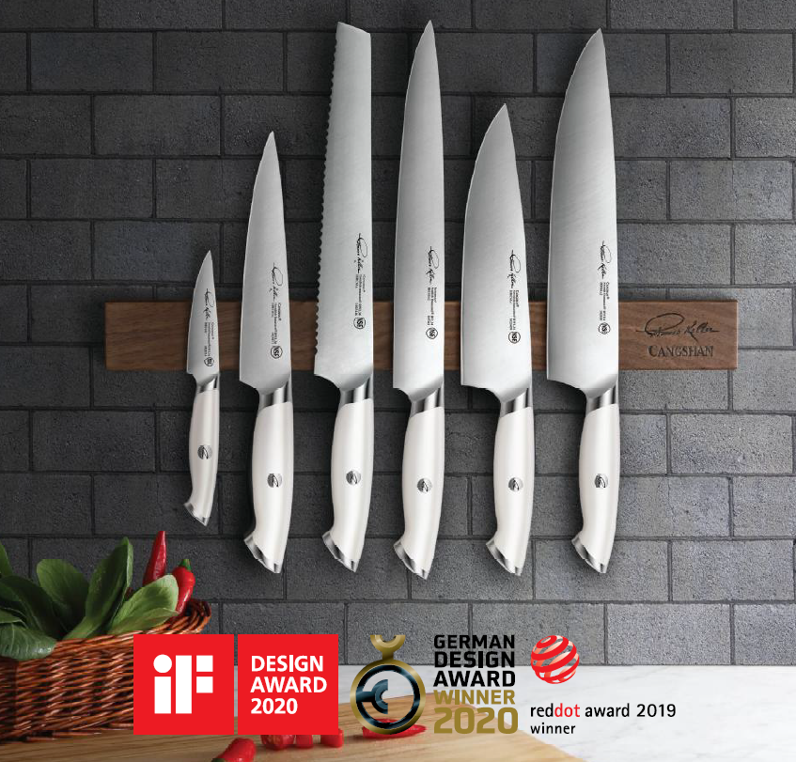

Slide 14
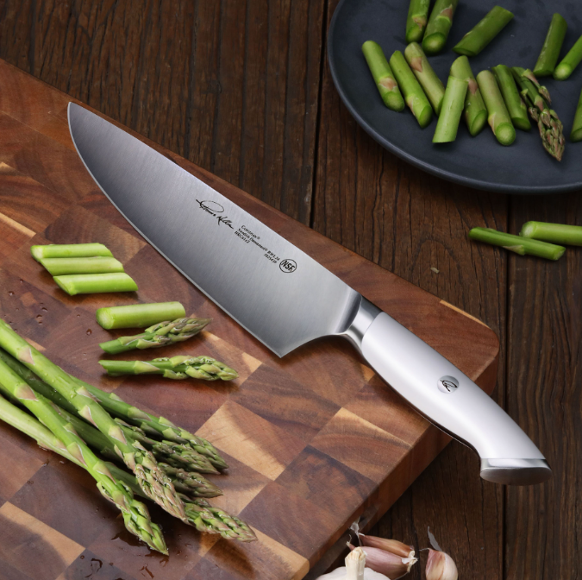
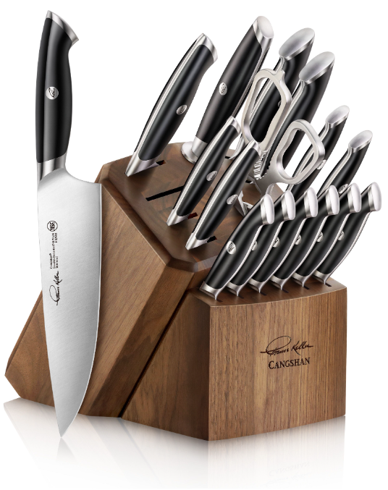
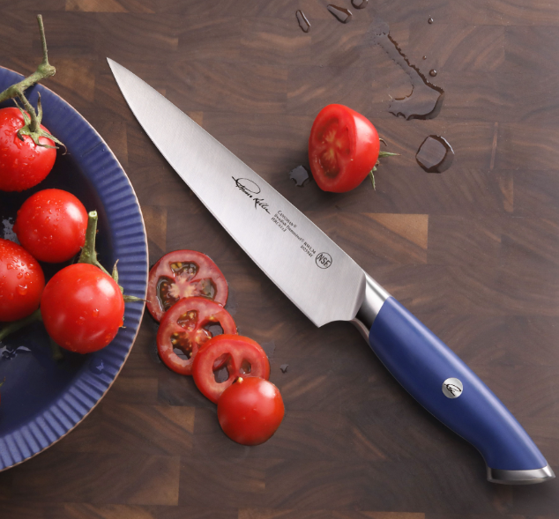
Thomas Keller
Signature Collection
Swedish Damasteel RWL34 (powder)

Slide 16
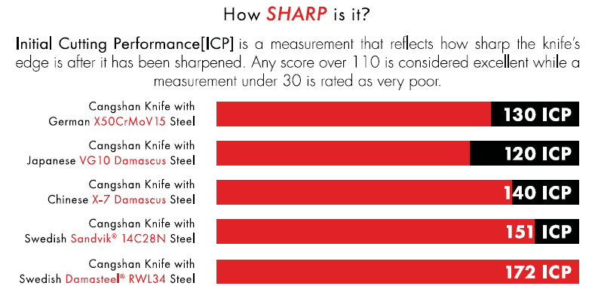

Slide 18
New Knife Lines
Olive
KITA
Swedish Sandvik Steel 14C28N
X-7 Steel
$129.95
$129.95
YARI
HAKU
X-7 Steel
Q1, 2023
X-7 Steel
$129.95
$129.95
HELENA
Q4, 2022
German Steel X50CrMoV15
$59.95

Slide 19
Swedish Damasteel RWL34 (powder)
61 Rockwell
$199
TK (Black)
TK (Blue)
Set Only
TK (White)
$199

Slide 20
Swedish Sandvik 14C28N
59 Rockwell
$99
TC
$99
TS
OLIV
$129
New Fall 2022

Slide 21
X-7 Proprietary (Improved VG-10)
61 Rockwell
YARI
$129
New Fall 2022
$129
KITA
New Fall 2022
$129
HAKU
New Fall 2022

Slide 22
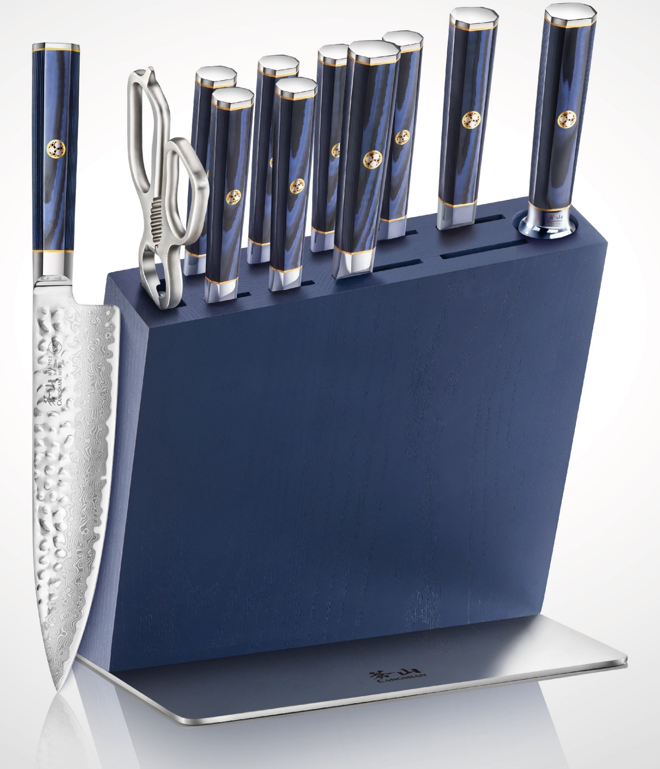
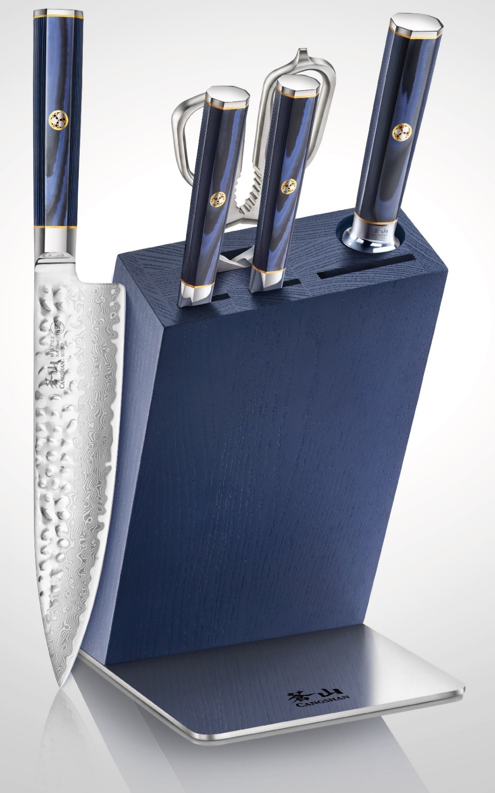
KITA
12 Pc Block Set
$699
6 Pc Block Set
$349

Slide 23
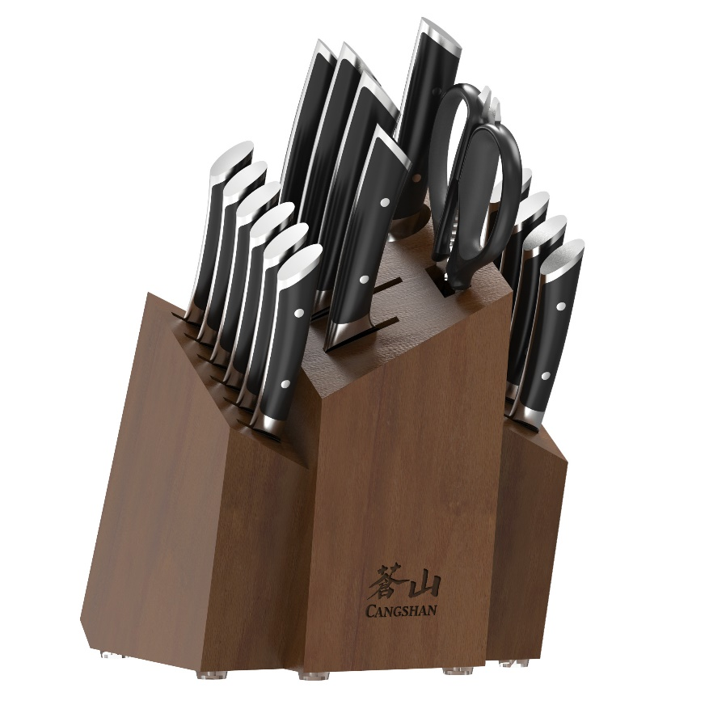
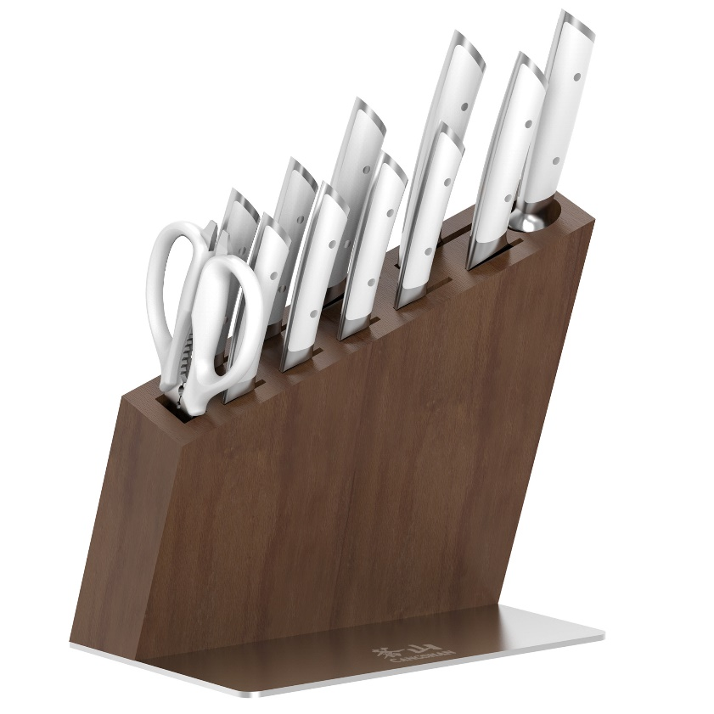
German Steel X50CrMoV15
58 Rockwell
$59
Helena
New Winter 2022
January
2023

Slide 24
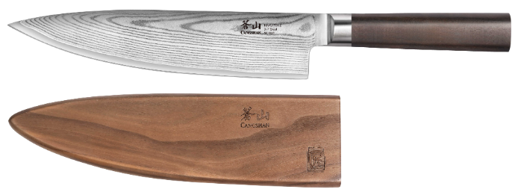
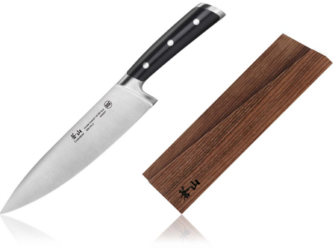
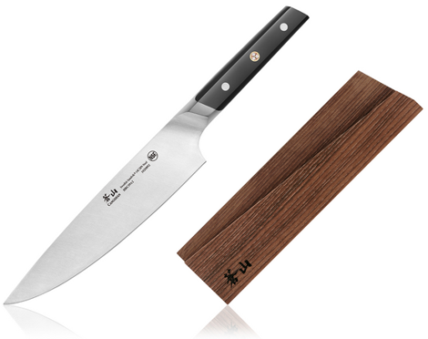
Wooden Magnetic Blade Sheaths

Slide 25
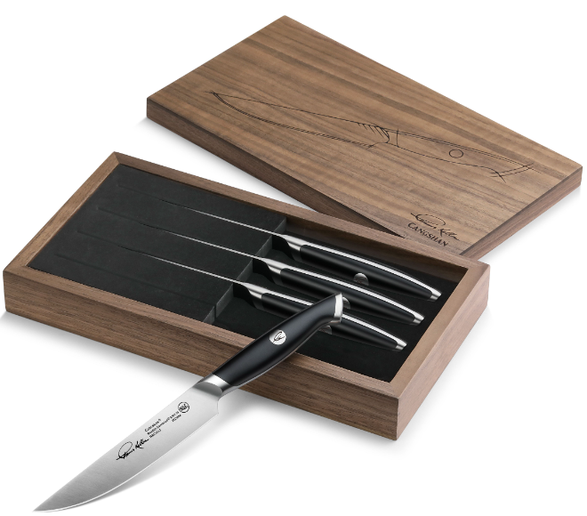
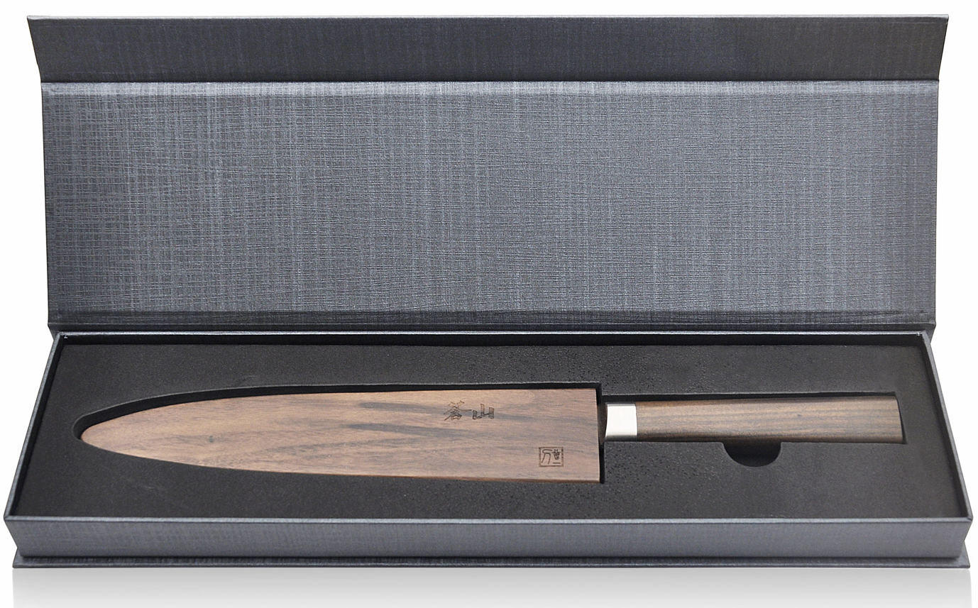
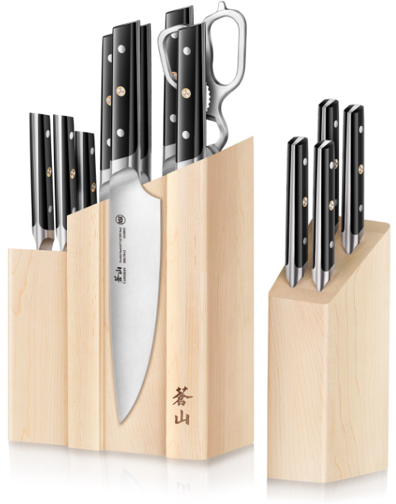
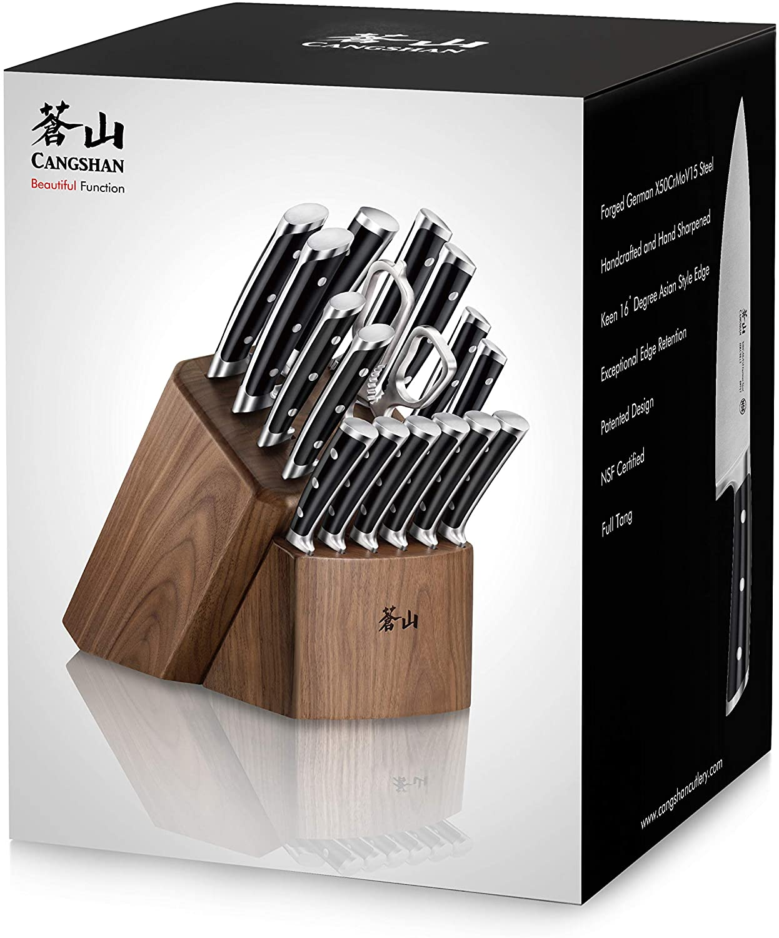
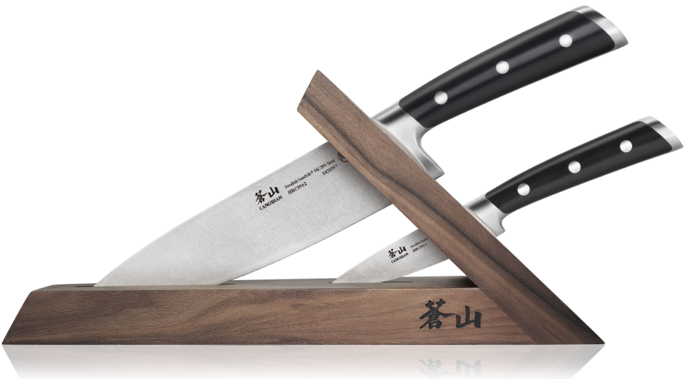
Best in Class Storage & Packaging

Slide 26
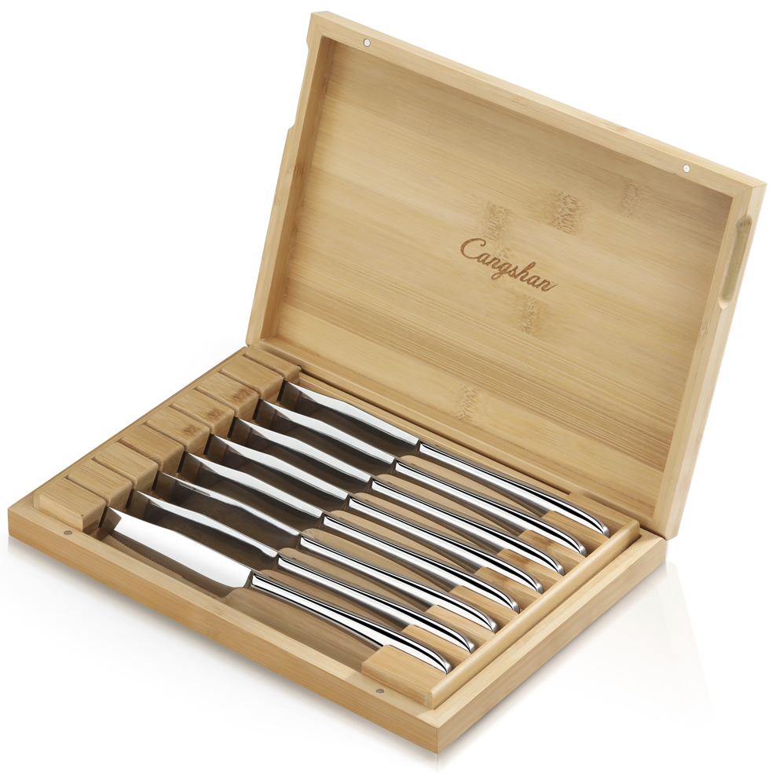
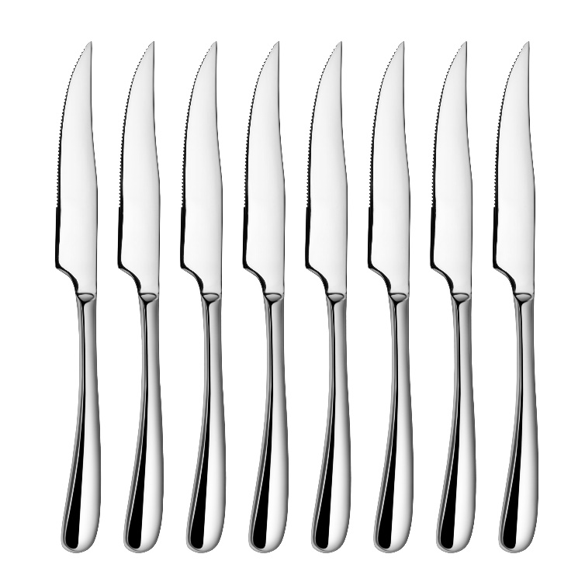
Black Friday
$59.95
Reg $79.95

Slide 27
Q4 Holiday – 6” Cook’s
$59.95
Reg $99.95
OLIV
HAKU
KITA
YARI- Q1 2023

Slide 28
“Our customers expect the attributes of truth, trust, and honesty from my staff and the products we sell. We have had great performances in two series. Cangshan has met my expectations.”
Des Moines, IA
- Teresa Adams-Tomka

Slide 29
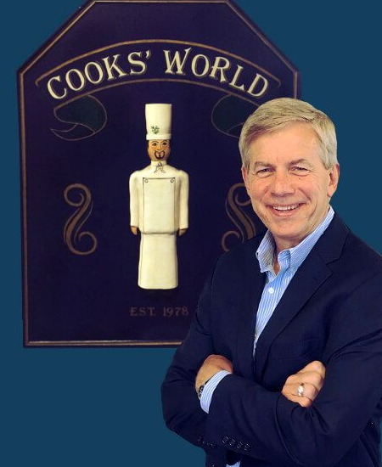
“Cooks World has been delighted with our newest cutlery partnership in Cangshan. From day 1, they have met our expectations with respect to customer service, build quality, unique style, and very attractive price points.
We are excited about this new partnership and even though we have only been a dealer for a little over a year, customer feedback has been very positive, and we have placed re-orders. We look forward to years selling Cangshan."
Rochester, NY
- Chris Wiedemer

Slide 30
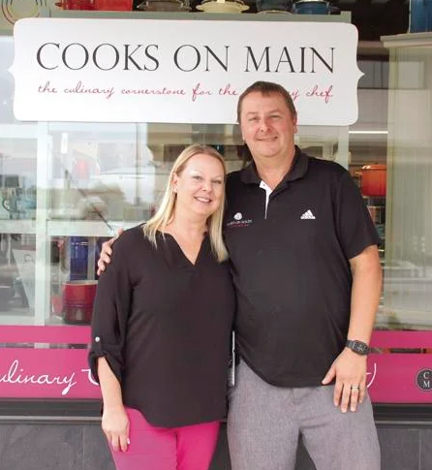
“Our customers have been delighted with the amazing quality at outstanding prices from Cangshan. The unique Swedish Sandvik steel has been admired by our millennials while the TN1 has been loved with its outstanding German steel and unbeatable prices.
Cooks on Main is so excited to see the new exciting line of Kita to help kick off their Holiday season with unbeatable prices. I know this will be the backbone to holiday sales for the cutlery category!! I can’t wait!”
Williston, ND
- Angela Skogen
Angela DeMars-Skogen
& John Skogen

Slide 31
Why Do We Care for GC Indep Retailers?
Essential for Brand Building
Educated & Influential Staff
TRUST = Personal Relationships
Mutual Benefits (Partnership)
It’s GOOD Business
We Need You!

Slide 32
Cutlery Training: July 7, 2022
Thank you!

