Slide 1
Greg Candler
Cuisinart Best Sellers

Slide 2
Atlanta Market @ Americas Mart
Presentation
July 14 at 3:15pm

Slide 3
CORE CUSTOM ™ 13-CUP FOOD PROCESSOR FP-130
Agenda:
Business Review
Gourmet Program Details (active)
Best Sellers
What's New & Trending
Questions

Slide 4
Business Review
After three consecutive record-breaking years, we’ve been forced to pivot due to shortage of demand.
Historically high inflation and workplace shortages are hitting the industry from top to bottom.
Independent retailers have been able to weather the storm, pacing last years numbers.
Plan of Action:
Introducing a new Unilateral Pricing Policy (UPP) on the e-com side with the goal of increasing brand equity and ensuring all qualified dealer margins are healthy and sustainable.
Implement authorization and verification process for all dealers. This will help in monitoring and enforcement while weeding out the unauthorized sellers who corrode our pricing strategies.

Slide 5
2022 Summer Discount Program
Cuisinart is excited to offer a Summer discount and dating program! All orders must ship during the month of July to qualify. This program applies to all Cuisinart Product.
Discount:
All product categories will receive a 5% discount on any order exceeding $2,500
All product categories will receive a 10% discount on any order exceeding $3,500
One (1) order will be allowed during this time period
Prepaid freight on $1,500
NET 60
Additional discount provided on Custom Clad 5-Ply Cookware Set and Open Stock.

Slide 6
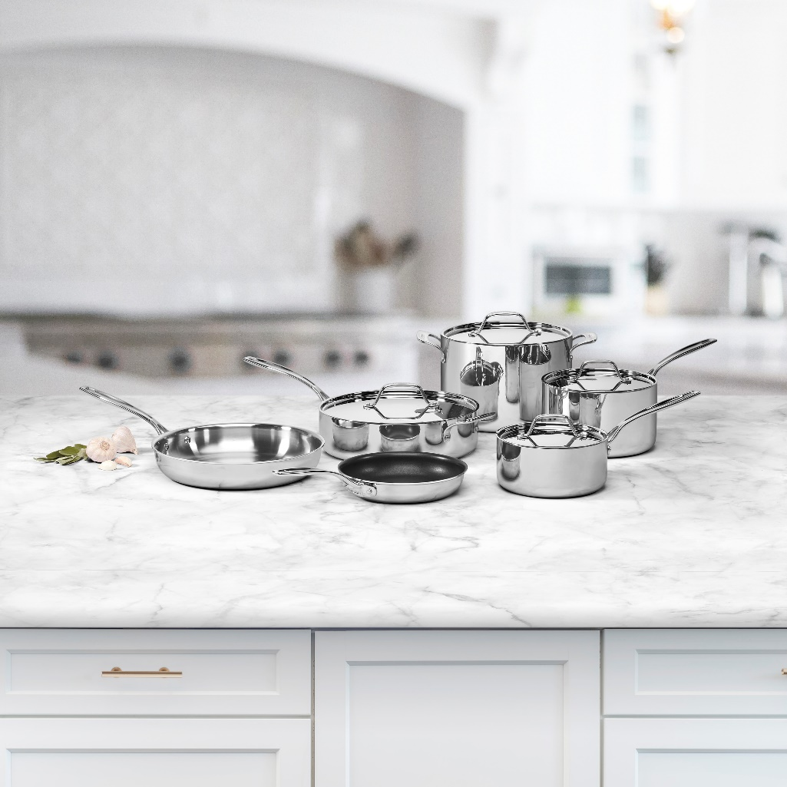
Custom Clad 5-Ply Stainless Cookware Collection
5% DISCOUNT WHOLESALE OF EACH LINE ITEM WITH PURCHASE OF FIVE (5) UNITS OR MORE
ENTIRE COLLECTION QUALIFIES
10 pc. Set and Open Stock
ITEM # | UPC | DESCRIPTION | Case Pack | WSP | PROMO COST | UPP
CC519– 14 | 086279191519 | 1 Qt. Saucepan w/ Cover | 2 | $22.00 | $20.90 | $39.95
CC522–20 | 086279191540 | 8" Fry Pan | 2 | $22.00 | $20.90 | $39.95
CC522–24 | 086279191656 | 10" Fry Pan | 2 | $30.00 | $28.50 | $59.95
CC5193-18 | 086279191755 | 3 Qt. Saucepan w/Cover | 2 | $35.00 | $33.25 | $69.95
CC522 -30H | 086279191670 | 12" Fry Pan w/ Helper Handle | 2 | $40.00 | $38.00 | $79.95
CC555-30H | 086279191816 | 5.5 Qt. Sauté Pan w/ Helper & Cover | 2 | $49.50 | $47.03 | $89.95
CC522–911 | 086279191700 | 2 pc. Fry Pan Set (9" & 11") | 2 | $50.00 | $47.50 | $99.95
SET:
CC5-10 | 086279191533 | 10 pc. Set | 1 | $236.00 | $224.20 | $429.95
CC519-18 2 Qt. Saucepan w/ Cover CC5194-20 4 Qt. Saucepan w/ Cover
CC5334–28H 4.5 Qt. Saute Pan w/ Helper & Cover CC566-24 8 Qt. Stockpot w/Cover
CC522–20NS 8" Nonstick Fry Pan CC522–28 11" Fry Pan

Slide 7
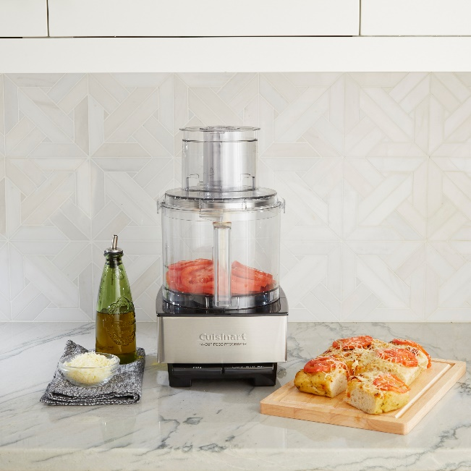
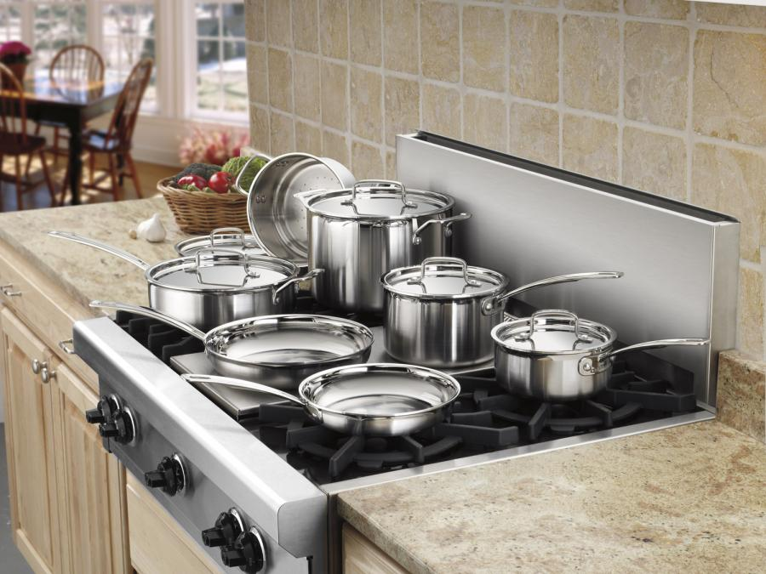
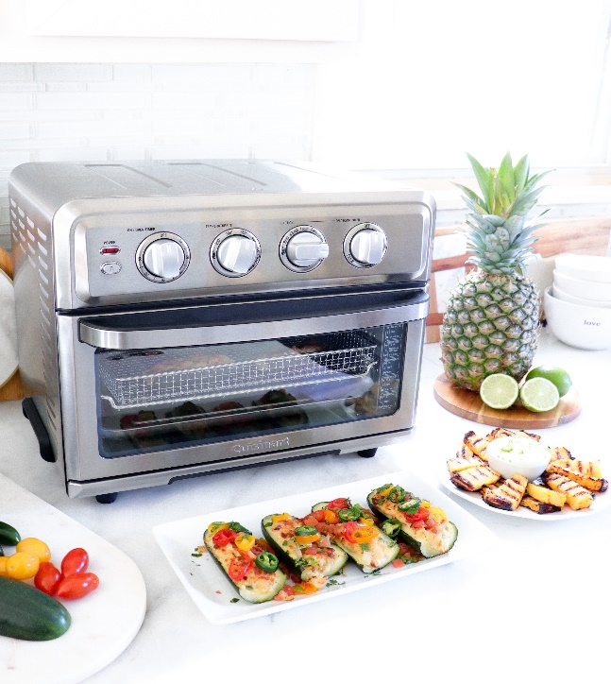
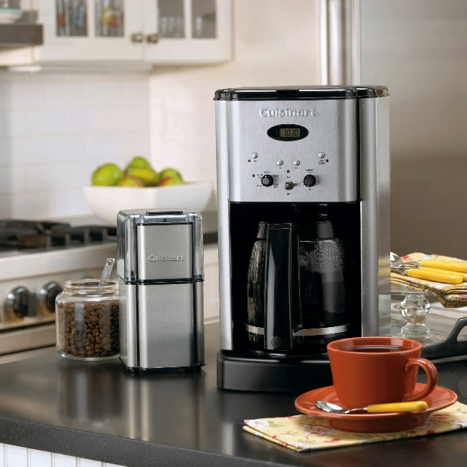
Top 20 Best Sellers in the Gourmet Channel
Top | Material | Description
1 | DFP-14BCNY | Custom 14 Food Processor (Brushed Stainless)
2 | TOA-70 | Air Fryer Oven with Grill
3 | DCC-RWF | Replacement Water Filters (2 Pack)
4 | WAF-F20P1 | Double Belgian Waffle Maker - Round
5 | DCC-1200P1 | 12-Cup Brew Central Programmable Coffeemaker
6 | FP-8SVP1 | Cuisinart Elemental 8-Cup Food Processor (Silver)
7 | DCC-3400P1 | 12-Cup PerfecTemp Programmable Coffeemaker (Thermal Carafe)
8 | TOA-65 | Digital Air Fryer Toaster Oven
9 | DCC-3200P1 | 14-Cup PerfecTemp Programmable Coffeemaker
10 | WAF-F40 | Double Flip Belgian Waffle Maker
11 | CSB-175SVP1 | Smart Stick® 2-Speed Hand Blender (Silver)
12 | FP-14DCN | Cuisinart Elite Collection™ 2.0 14-Cup Food Processor (Die Cast)
13 | SM-50BC | 5.5-quart Stand Mixer (Silver Lining)
14 | MCP-12N | Multi-Clad Pro Tri Ply 12 pc. Cookware Set
15 | FP-11SVP1 | Cuisinart Elemental 11-Cup Food Processor (Silver)
16 | DBM-8P1 | Supreme Grind Automatic Burr Mill
17 | SFP-13 | Cuisinart Elemental 13-Cup Food Processor (Stainless Steel)
18 | CSB-175P1 | Smart Stick® 2-Speed Hand Blender (White)
19 | CSB-179P1 | Smart Stick® Variable Speed Hand Blender w/3 Cup Chopper
20 | HM-50 | Power Advantage® 5-Speed Hand Mixer

Slide 8
What’s New/Trending in Electrics?

Slide 9
Coffee

Slide 10
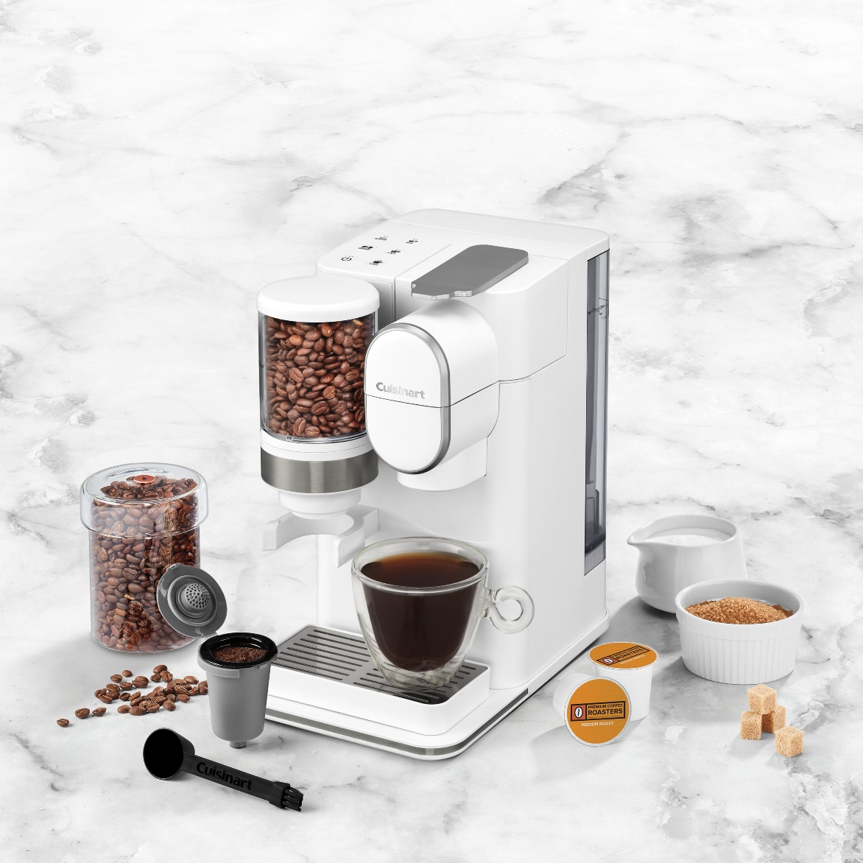
Grind and Brew Single Serve Coffeemaker DGB-2W
Capsule Brewing System- Brew a single serving with freshly ground beans or use your favorite pod
Compatible with any single cup pod, including Keurig K Cup®
Includes Cuisinart's HomeBarista® Reusable Filter Cup which lets you use your own coffee. Integrated storage holds capsule when not in use
Built-in conical burr mill for fresh-ground coffee
Hopper holds 100g of beans, sealed lid keeps beans fresh
Grinds directly into the HomeBarista®
Removable 48oz water reservoir
3 beverage sizes –8/10/12oz.
Removable drip tray for travel mugs
Charcoal water filter
Limited 3-year warranty
UPP Retail:
Availability:
$149.95
August 1, 2022

Slide 11
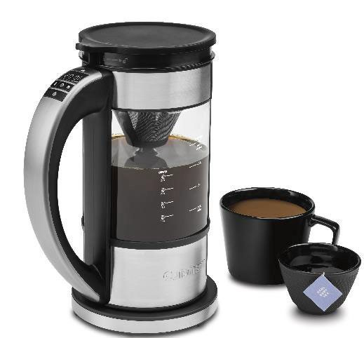
Programmable 5-cup Percolator & Kettle
FCC-1
Multi-beverage system-brews up to 5 cups of coffee
Double as a 1-liter electric kettle
Unique brewing system circulates water from bottom while maintaining a constant temperature to optimize extraction
LED displays customizable settings
Adjustable temperature, from 160-212F, and adjustable brew time (3- 8min) for customized and different types of beverages
Adjustable strength control- mild, med, bold
Stainless steel filter basket- unique v-shaped for superior flavor
Countdown timer shows you time since brewed
30-minute Keep Warm option
Memory feature let you lift kettle body off base while maintaining settings
Limited 3-year warranty
UPP Retail:
Availability:
$129.95
August 1, 2022

Slide 12
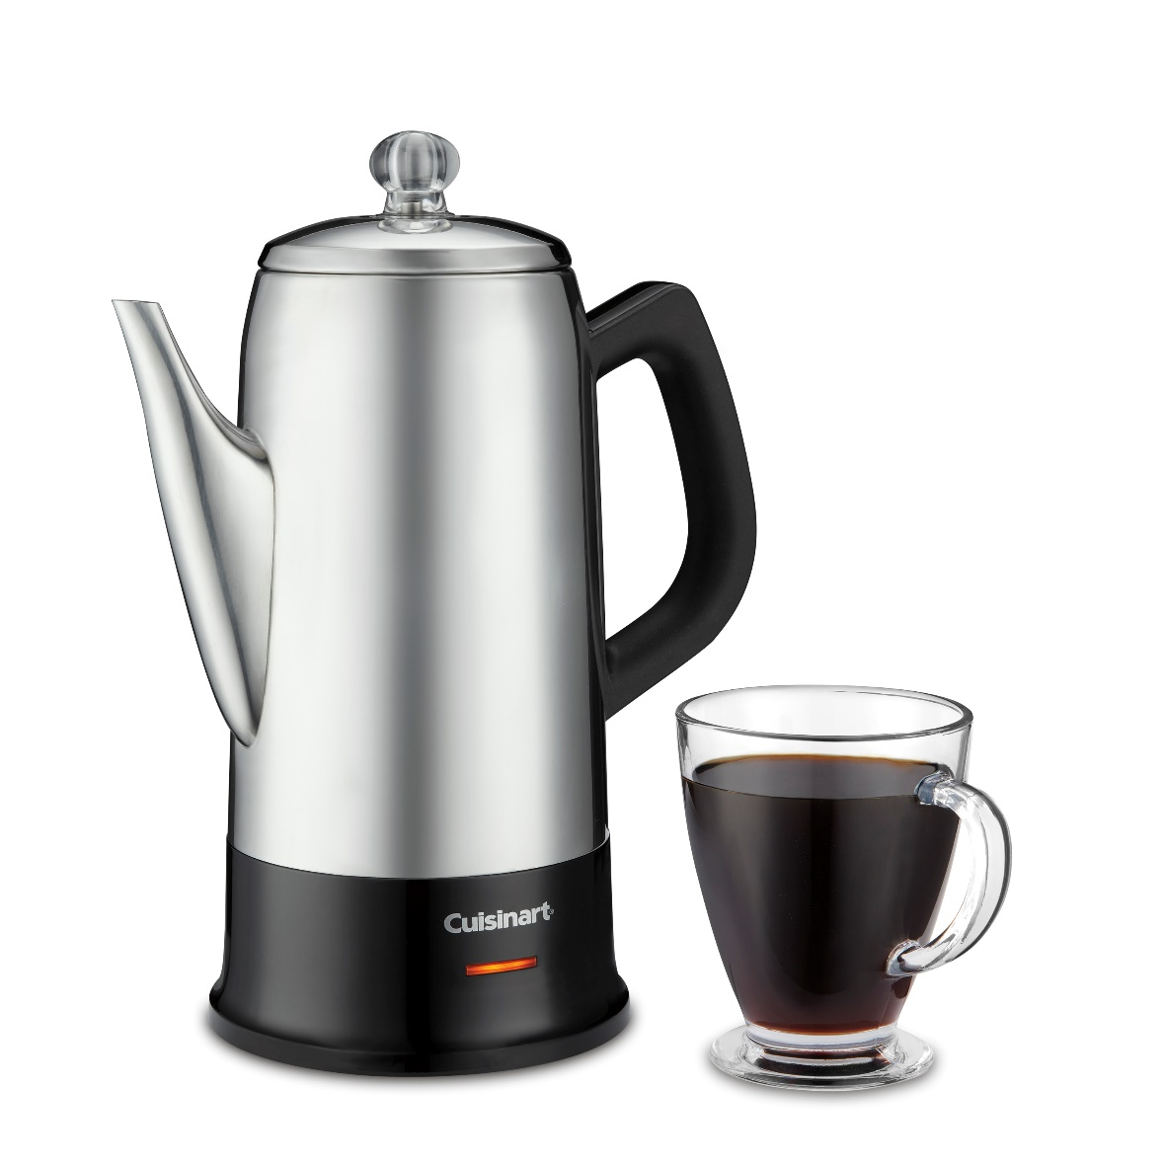
Cuisinart® Classic 12-cup Percolator
PRC-12N
Convenient capacity of 6 to 12 cups
Precision no-drip spout: long, tapered and pours without a spill
Stainless steel housing
Transparent knob reveals progress of the brew cycle
Comfortable handle
Stay-cool bottom – sits safely on any surface without scarring
Ready indicator light shows when coffee is ready to pour and enjoy
Detachable cord
Limited 3-Year Warranty
UPP Retail:
Availability:
$79.95
Now

Slide 13
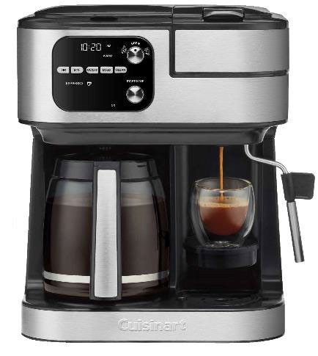
Coffee Center® Barista Bar 4-in-1 Coffeemaker
SS-4P1
12 Cup Coffeemaker with Single Serve cup brewer, Nespresso ® Capsule brewer, and Steam Wand for Hot water or Milk
Drip Coffee:
12-cup glass carafe
Fully automatic with 24-hour programmability, Adjustable Keep Warm and Auto shutoff (0–4 hours)
Brew Pause™ feature
Brew strength control
Gold tone, commercial-style, permanent filter
Charcoal water filter
Single Serve Brewer:
Compatible with any brand of single-cup pod, including Keurig K-Cup® pods
3 brewing sizes: 6oz, 8oz, 10oz
42 oz Removable Water Reservoir
Nespresso® Capsule Brewer:
Compatible with Nespresso® OriginalLine-style capsules
Single or Double espresso sizes
Steam Wand for hot water, steamed or frothed milk
Limited 3 Year Warranty
UPP Retail:
Availability:
$299.95
October 1, 2022

Slide 14
Food Processors

Slide 15
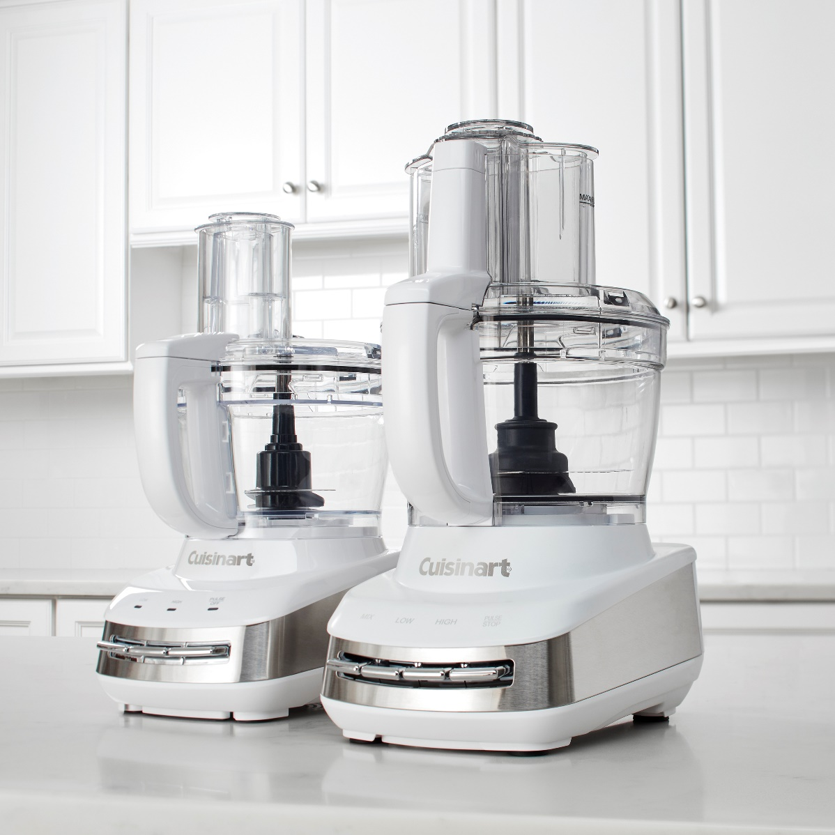
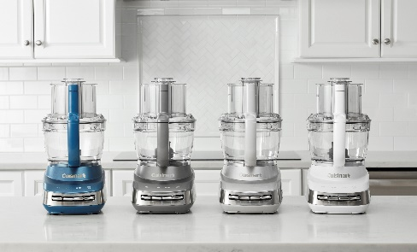
Core Custom™ 10 / 13-Cup Food Processors FP-110 / FP-130
New motor platform enables this versatile food processing system to offer variety of functions, attachments and accessories
BasicAccessories: Chopping Blade, Adjustable Slicing Disc, and Reversible Shredding Disc
Additional Accessories to be sold separately: Blender Jar, Juicing Center, Dicing Kit, Small Work Bowl, Specialty discs and more
Innovative Storage Solution:All basic attachments store inside the work bowl
Control Pedals: High/Low/Pulse speeds
Mix speed
Tritan Bowl and Lid with seal. Large, medium and small pushers
Beautifully lit control panel
UPP Retail:
Availability:
$249.95
Now

Slide 16
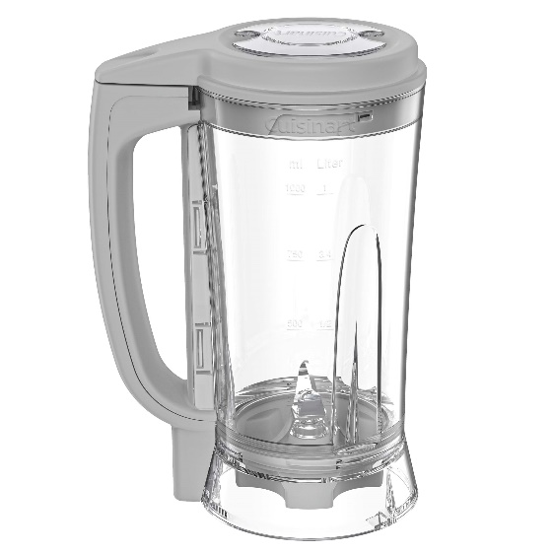
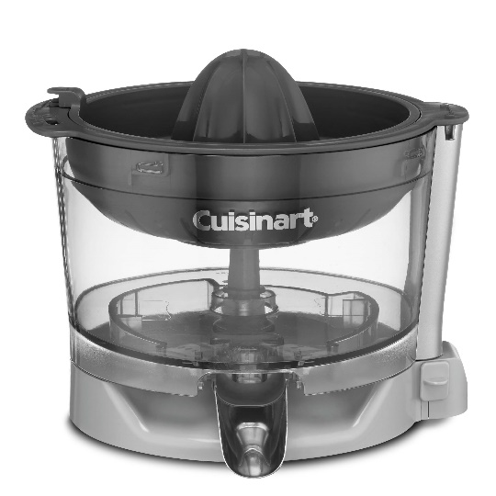
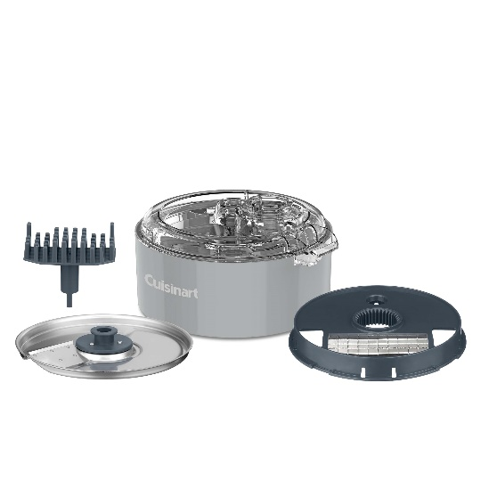
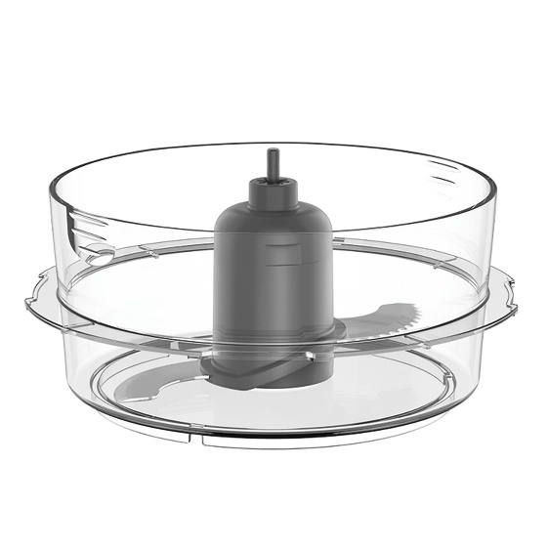
Cuisinart Core Essentials™
MFP-JC
Juicing Center
$69.95 UPP
MFP-B36
36 oz. Blender
$39.95 UPP
MFP-WB4
4 ½ Cup Work Bowl
$29.95 UPP
FP-DCP1
Dicing Kit
$49.95 UPP

Slide 17
Toasters

Slide 18
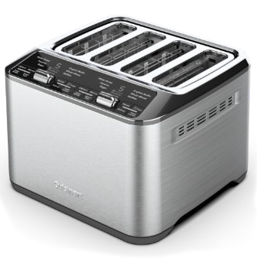
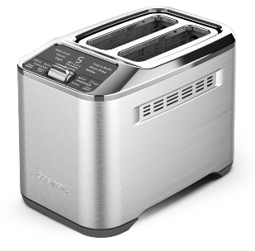
Motorized 2-Slice / 4-Slice Toasters CPT-520/540
Lever-less operation with motorized lift
6 bread types: White, Wheat, Bagel, Pastry, English Muffin, Waffles
MemorySet feature – easily save and select your favorite settings
QuickView to check toast progress
Defrost, +30 Sec and Single Slice options
7 shade settings
Large digital display with countdown
Stainless steel housing
4S - Dual control panels
UPP Retail:
Availability:
$79.95 / $99.95
Now

Slide 19
AirFryers

Slide 20
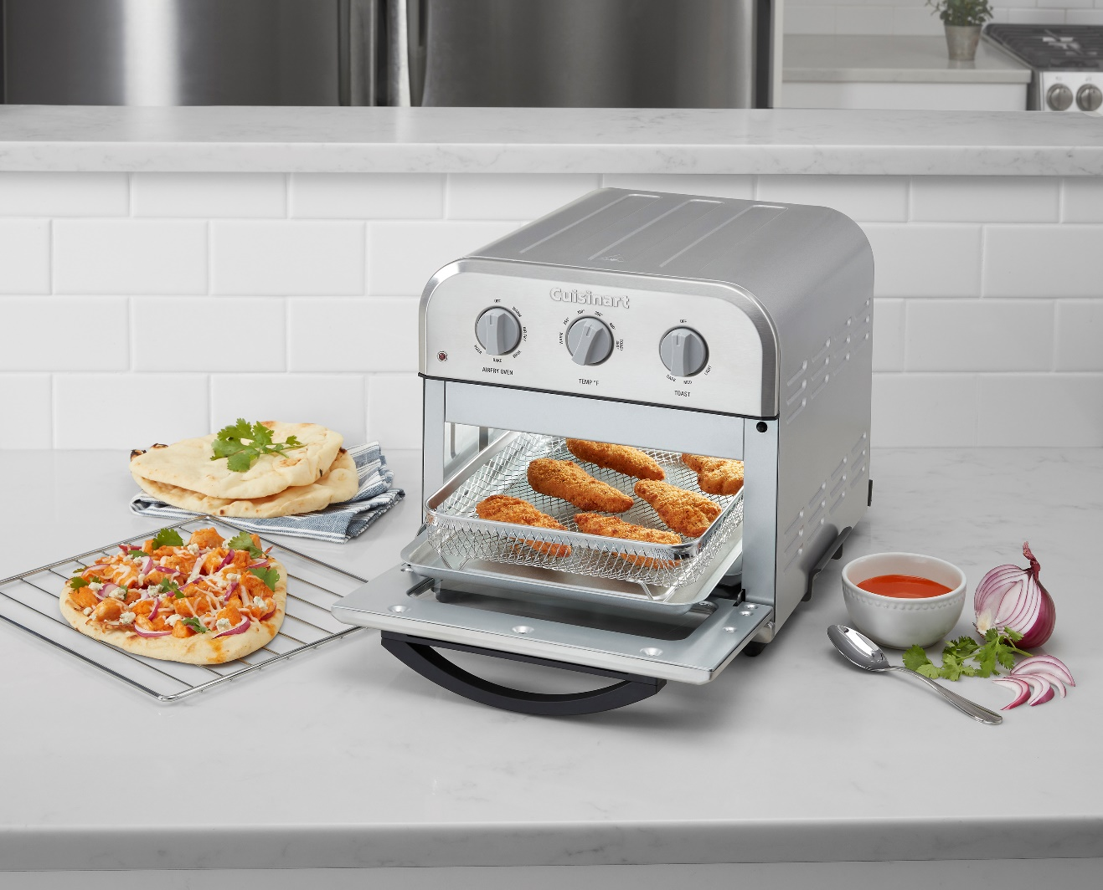
Compact AirFryer Toaster Oven TOA-26
Compact design takes up less space on the countertop
Large capacity to AirFry up to 2.5 lb.
6 functions: Convection Bake, Convection Broil, AirFry, Toast, Pizza and Warm
Adjustable temperature (Warm–450°F)
Toast shade selector timer
Whisper-quiet operation
Stainless steel styling with viewing window
Nonstick, easy-clean interior
Includes: AirFryer basket, baking/drip tray and oven rack
UPP Retail: $129.95
Availability: Now

Slide 21
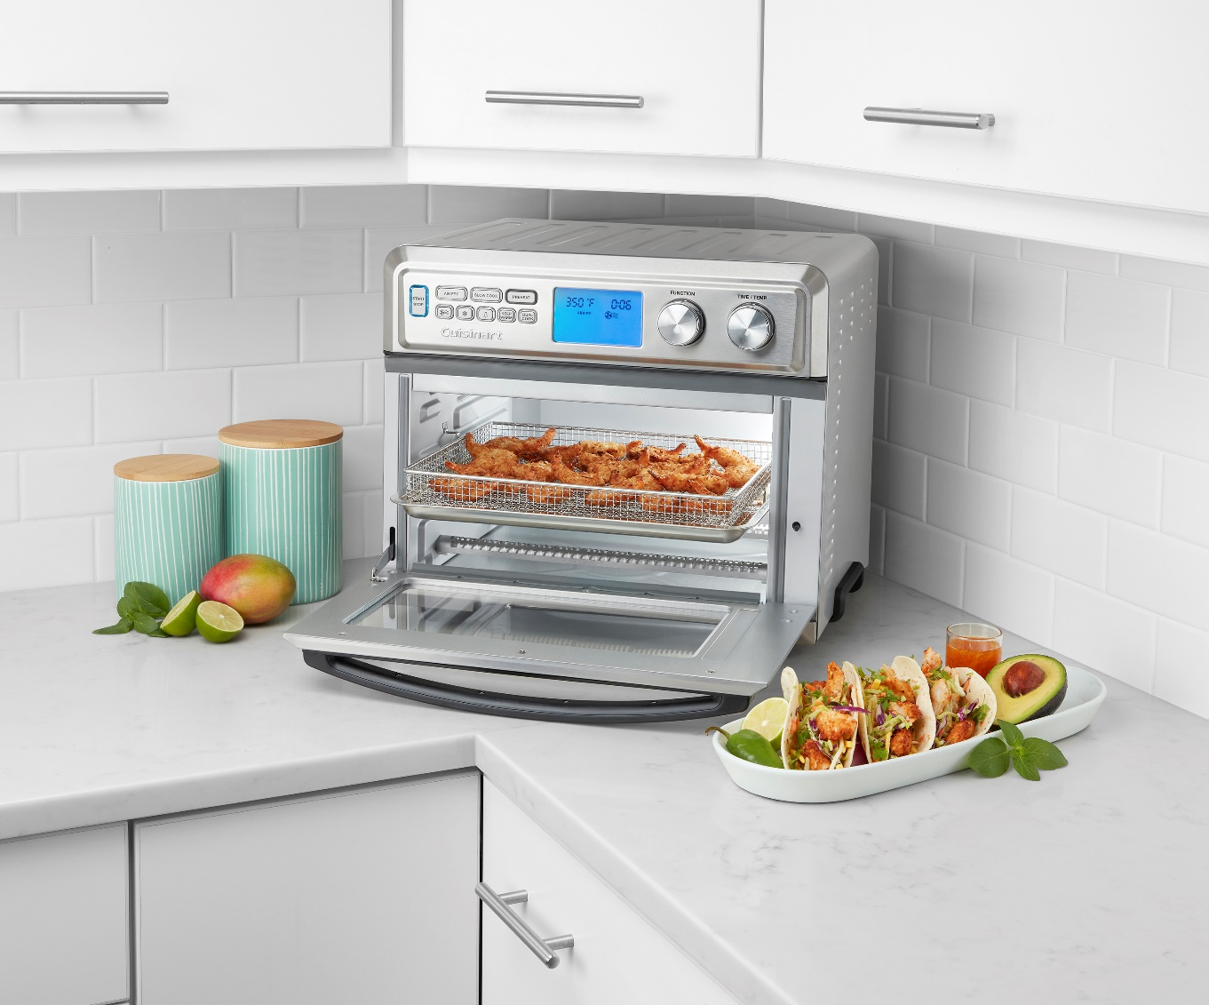
Large AirFryer Toaster Oven TOA-95
0.95 Cubic Ft. – Large enough toAirFry up to 4lbs, toast 9 slices of bread, a 13” pizza or a 9” x 13” baking pan
Multiple Cooking Functions
AirFry, Bake, Broil, Pizza, Roast, Dual Cooking, Reheat, Keep Warm, Toast, Bagel, Dehydrate, Low, Slow Cook
AirFry Presets
Toast Shade Selector and Defrost option
High & Low Speed Convection
Adjustable Cooking Temperatures (up to 450°F) and Times
Nonstick Easy-Clean Interior and dishwasher safe accessories
Whisper-quiet Operation
Interior Light
Includes: Oven Rack, Baking Pan & Air Fryer Basket, Crumb Tray
1800 Watts
UPP Retail: $329.95
Availability: Now

Slide 22
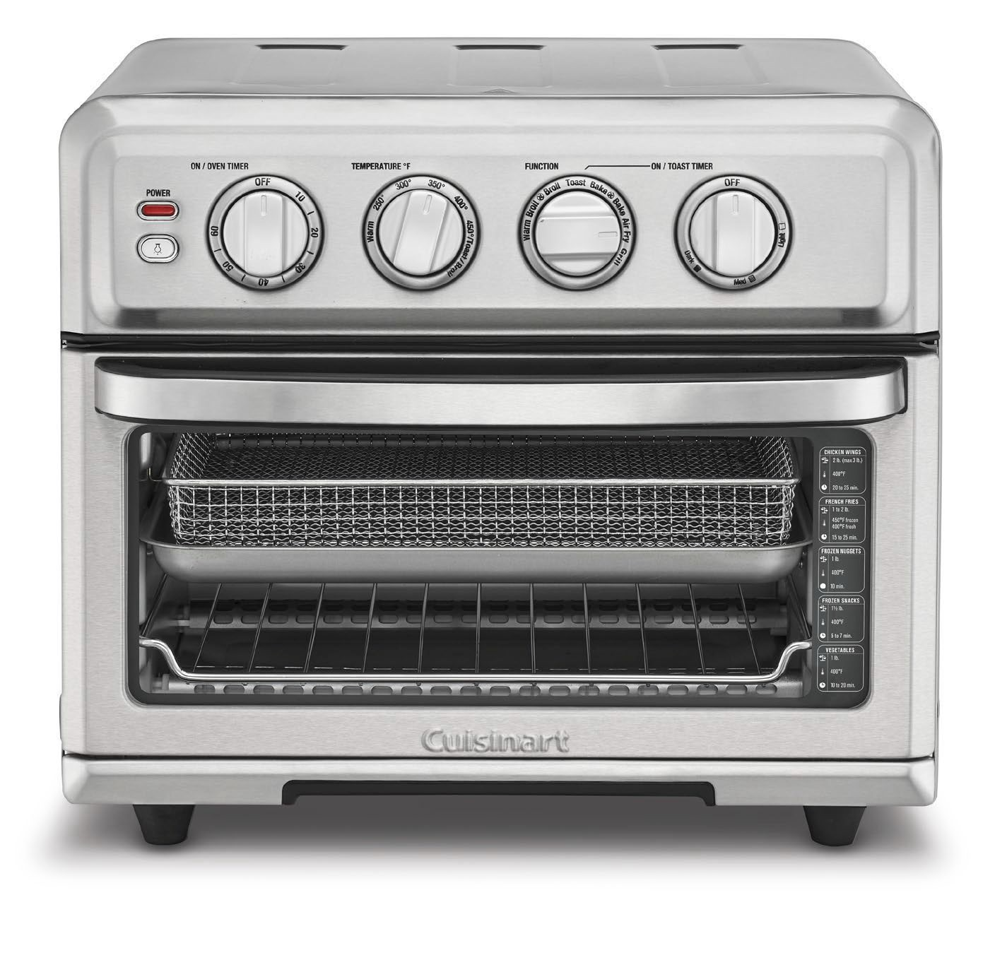
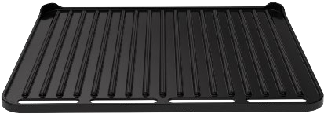
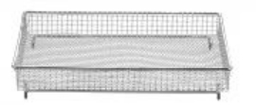
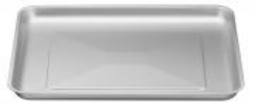
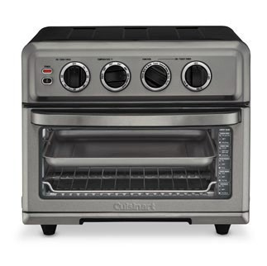
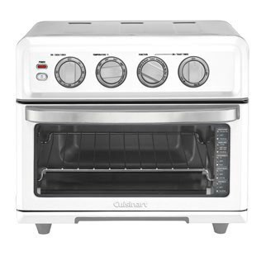
AirFryer Toaster Oven With Grill TOA-70
NEW Grill Feature!
NEW Grill Feature – cooking function & grill accessory included
0.6-cubic-foot interior with light; 3 lb.AirFry capacity
8 functions include:Air Fry, Convection Bake, Convection Broil, Bake, Broil, Warm, Toast and Grill
Adjustable temperature (up to 450F)
60-minute timer/auto shutoff
Toast shade selector timer
Nonstick, easy-clean interior
Enlarged window with integrated cooking guide
Includes: oven rack, baking pan, airfryer rack/basket and grill
Whisper-quiet operation
1800 Watts
UPP Retail: $229.95
Availability: Now

Slide 23
Waffle Makers

Slide 24
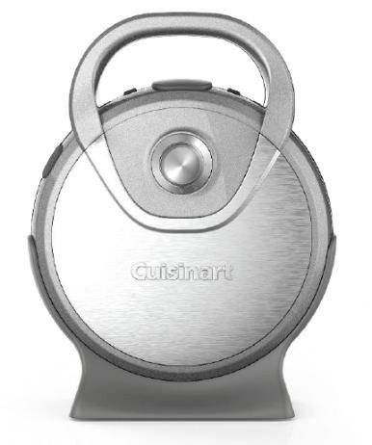
Stuffed Waffle Maker WAF-S100
Stuffed Waffles can bake your favorite toppings inside the waffle, and they can be sweet or savory
Two sets of removable plates
One set will bake a 6“ diam., 1" thick stuffed waffle. Second set will bake a 6", 1/2" thick Classic Non-Stuffed Waffle
5-Setting shade control
Ready-to-Bake and Ready-to-Eat indicator lights & an AudibleAlert
Non-stick baking plates
Locking handles for upright storage
Brushed stainless steel cover
Limited 3-year warranty
UPP Retail: $79.95
Availability: September
Images are for referenceonly. Final product is subject to change

Slide 25
Popcorn Makers

Slide 26
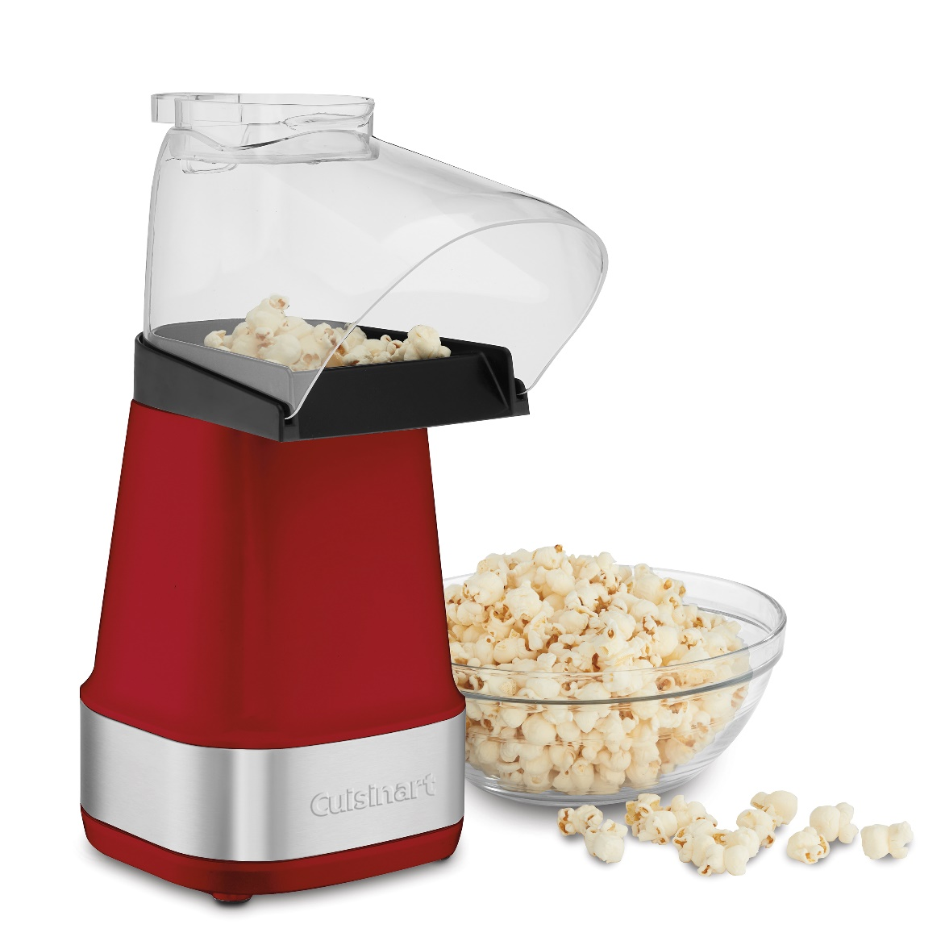
Easypop™ Hot Air Popcorn Maker CPM-150
NEW
Makes up to 15 cups of popcorn in 3 minutes or less
1500 watts of power
On/Off/Cool switch
Removable chute includes kernel measuring cup
Cool Air function helps to clean the popping chamber of kernel pieces and cools the unit for faster storage
Stainless Steel Logo accent wrap
All removable parts are top rack dishwasher safe
Comes in red or white (CPM-150W)
Limited 3-year warranty
UPP Retail: $39.95
Availability: Now

Slide 27
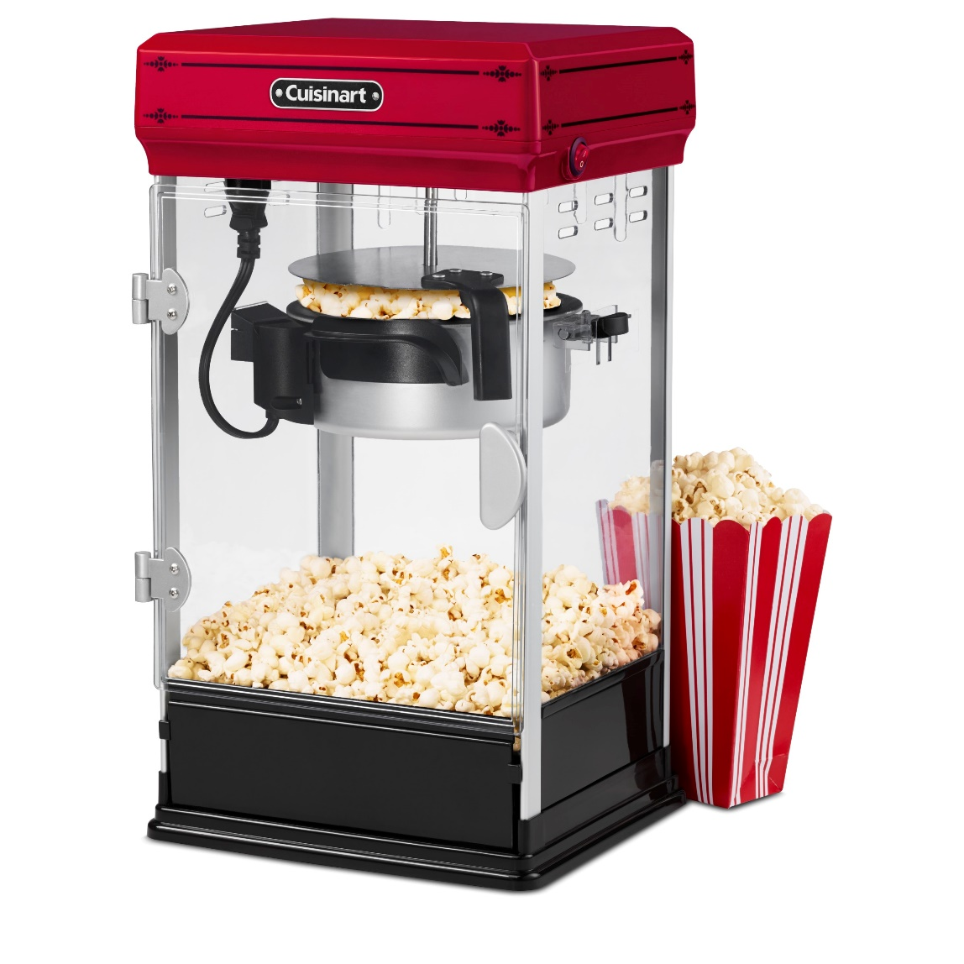
Classic Style Popcorn Maker CPM-28
Creates up to 10 cups of fluffy, delicious popcorn
No heat-up time required
Mechanized spinner moves kernels to ensure even cooking
Tilt access door for easy serving
Door and non-stick kettle are removable for fast cleanup
Includes popcorn scoop, kernel measuring cup and oil measuring spoon
Limited three-year warranty
UPP Retail: $129.95
Availability: Now
Proposed Updated Artwork Images are for referenceonly. Final product is subject to change

Slide 28
Stand Mixers

Slide 29
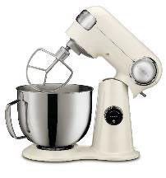
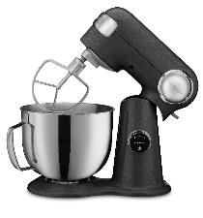
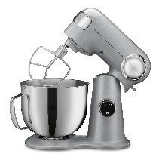
Precision Master Pro 5.5-quart Digital Stand Mixer
12 speeds for precision mixing
Powerful 500-watt motor
LED Digital Display, dial illuminates when operating
3 Preset programs include 7 recipe tasks to take the guesswork out of using your mixer
Countdown Timer with Auto-off feature
Tilt-back head allows easy access to the mixing bowl
Polished stainless steel 5.5 Qt. Bowl with helper handle
Die-cast metal construction
Power hub for optional attachments
Includes chef’s whisk, dough hook, flat mixing paddle, splash guard with pour spout
Limited 3-year warranty
SMD-50CRM
Cream
SMD-50GRPH
Graphite
NEW
UPP Retail: $299.95
Availability: Now
SMD-50BC
Silver Lining avail. Q2

Slide 30
Blenders

Slide 31
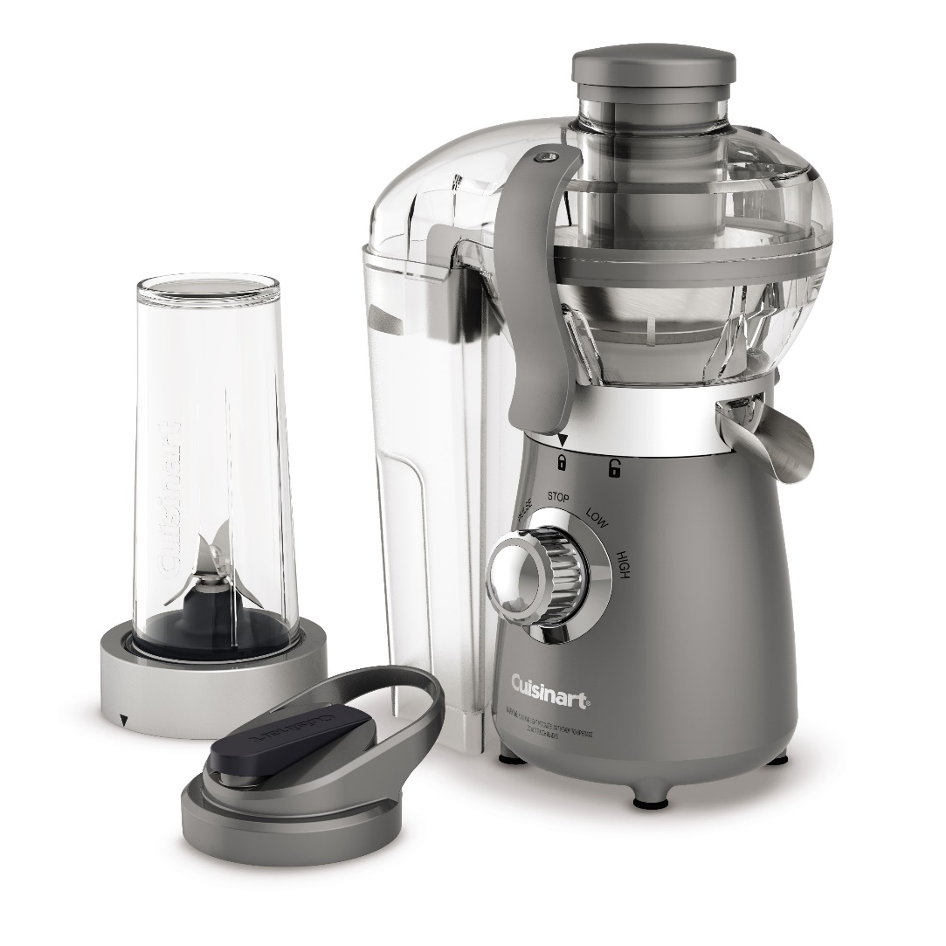
Compact Blender And Juice Extractor Combo CBJ-450
Compact blender juice extractor combo
450-watt peak motor
Blender includes 16-oz blending cup with flip travel lid
Juice extractor produces 8 to 16 ounces of fresh juice
Illuminated LED control
Rotary dial with High/Low/Pulse selection
Pulp container for easy cleaning
Juice extractor includes lid buckles for opening and closing safely
Non-slip rubber feet to keep machine steady
Dishwasher safe parts
Limited 3-year warranty
UPP Retail: $79.95
Availability: Now

Slide 32
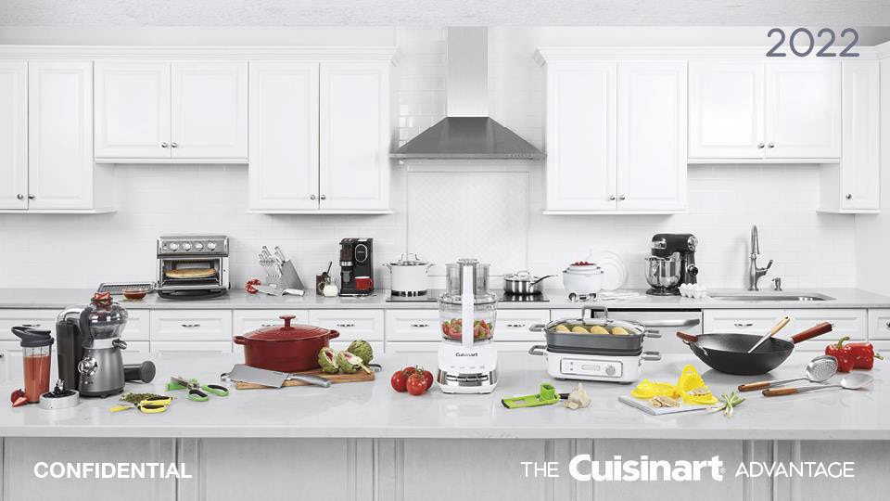
Non-Electrics

Slide 33
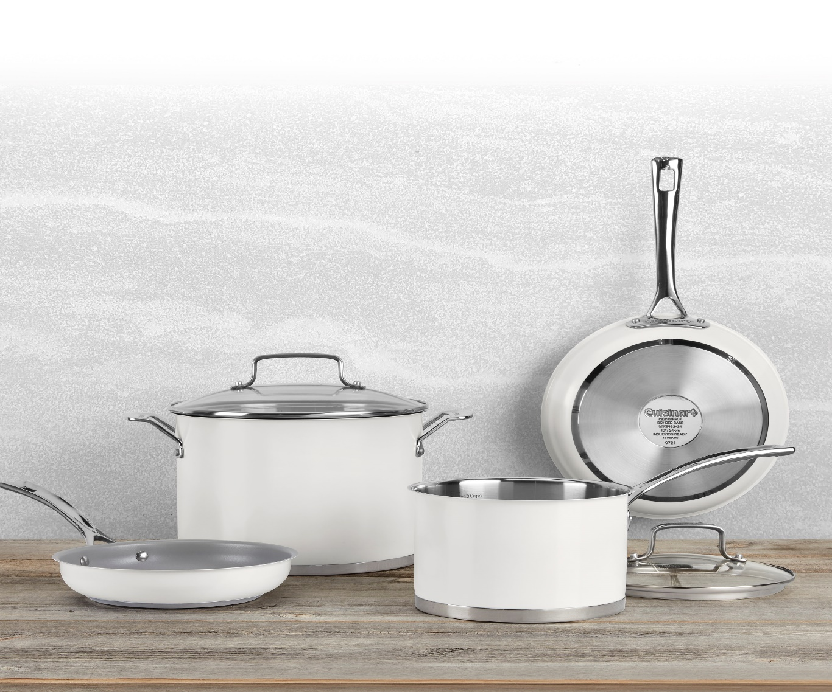
11pc. Matte White Stainless Set MW89-11
Specifications:
Premium stainless-steel construction
Matte white painted exterior
Stainless steel interior (nonstickinterior on 8″skillet)
PowerBond™ high impact bonded base
Cast stainless steel cool grip™ stick handles
Tempered glass lids
Measurement markings in cups and liters (exceptfor
skillets and everyday pans)
Compatible with all stovetops including induction
Dishwasher safe
Lifetime Warranty
UPP Retail: $229.95
Availability: Now

Slide 34
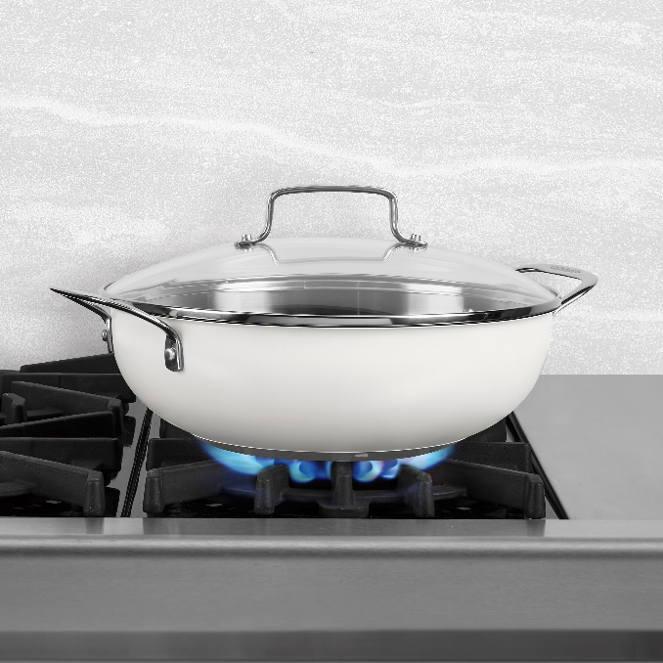
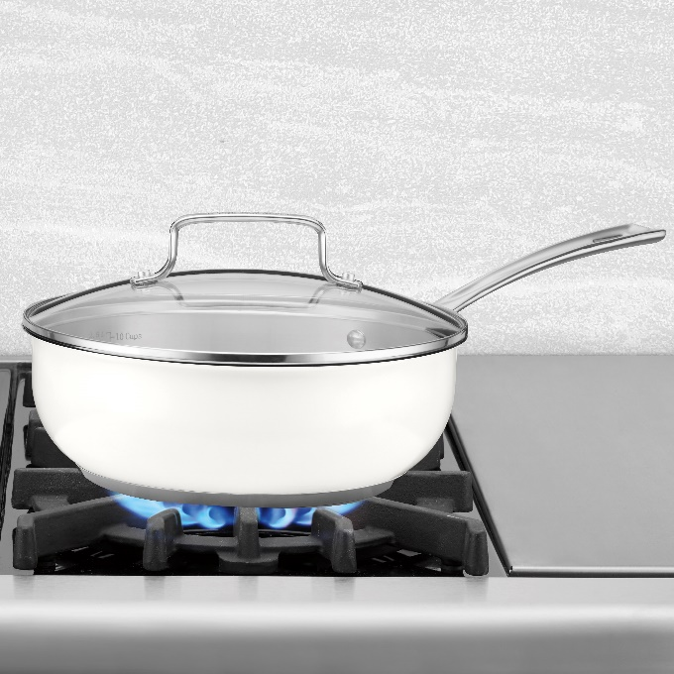
Matte White Stainless Open Stock
MW893545-24
4.5 Qt. Dutch Oven with Cover
UPP Retail: $49.95
MW8966-22
6 Qt. Stockpot w/ Cover
UPP Retail: $59.95
MW8926-30SD
12″ All Purpose Pan with Cover
UPP Retail: $44.95
MW8935-24
3 Qt. Chef’s Pan with Cover
UPP Retail: $54.95
MW8922-20NS
8″ Nonstick Skillet
UPP Retail: N/A
Available Now

Slide 35
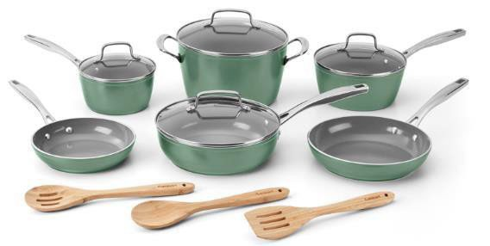
Greenchef® Ceramica® XT Non-Stick Set
53G-13SG
Specifications:
ForgedAluminum Bodies
Colored Sage Green Exterior
Exclusive Ceramica® XT Nonstick Interiors
(titanium reinforcedceramic)
Recycled Stainless Steel Handles
Tempered Glass Lids
Bamboo Kitchen Tools Included
Packaging: Recycled Materials
& Printed in Soy Ink
13-Pc Set
1.5 Qt. Saucepan with Cover
2.5 Qt Saucepan with Cover
3 Qt. Sauté Pan with Cover
6 Qt. Stockpot with Cover 8″ Skillet
10″ Skillet
Bamboo Solid Spoon
Bamboo Slotted Spoon
Bamboo Slotted Turner
UPP Retail: $179.95
Availability: Now

Slide 36
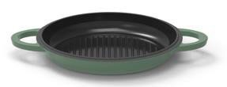
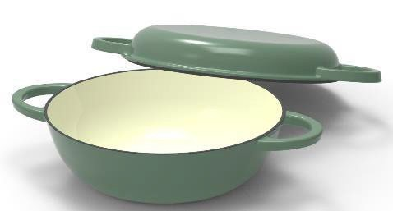
Classic Cast Iron 2-in-1 Multipurpose Set
CI5528-2SG
Specifications:
4 Qt. All Purpose Pan
11″ Round Grill Pan (can be used as cover) Compatible with all Stovetops Including Induction
Durable Cast Iron Construction
Porcelain Enamel Interior & Exterior
Dishwasher Safe
Lifetime Warranty
UPP Retail: $79.95
Availability: Now

Slide 37
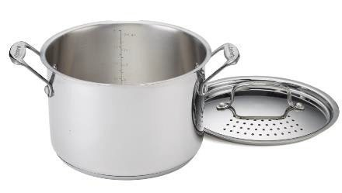
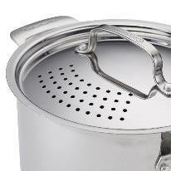
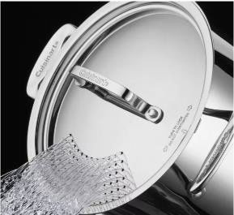
Chef’s Classic™ 6 Qt. Stainless Steel Pasta Pot w/ Straining Cover
766S-22
Specifications:
Stainless Steel Construction
Easy-to-Use – Boil & Strain in One!
Offers Convenience – Eliminatesneed for a colander
Uniquely Designed Straining Lid Securely Fastens
Measurement Markings in Cups and Liters
Compatible with All Stovetops Including Induction
UPP Retail: $54.95
Availability: Now

Slide 38
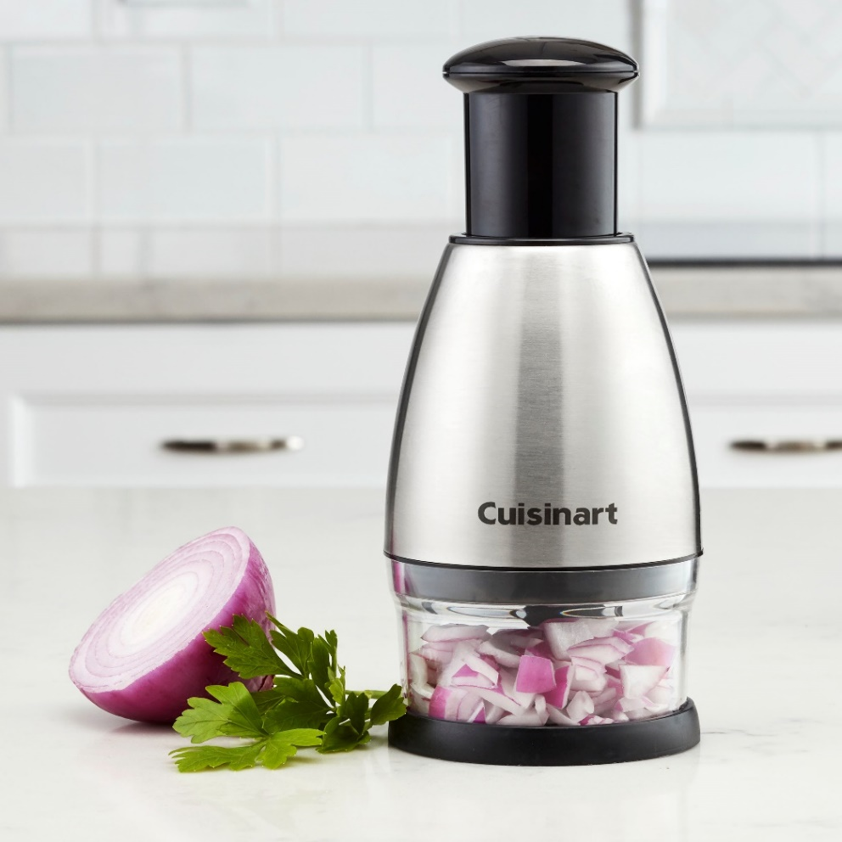
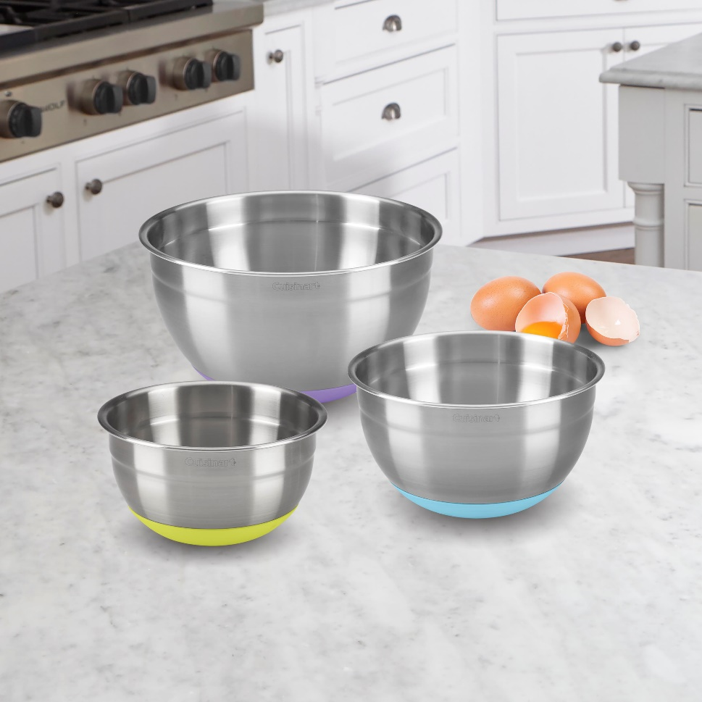
Best
Sellers
Set of 3 Stainless Steel Mixing Bowls with Non-slip Base
Push Chopper
UPP Retail: $24.95
Availability: Now
UPP Retail: $39.95
Availability: Now

Slide 39
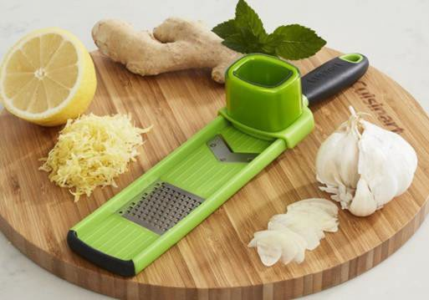
GARLIC SLICER & GRATER CTG-00-GS
Chop, Shred, Slice
2 Cutting options:
Slice & Grate
Food holder, pusher and blade cover for added safety
Blades constructed of durable stainless steel
Dishwasher safe
Lifetime warranty
Packaging: header card
Perfect for garlic, ginger, radish, nutmeg, and citrus zest!
UPP Retail: $9.95
Availability: Now

Slide 40
Questions?

